Slide 1
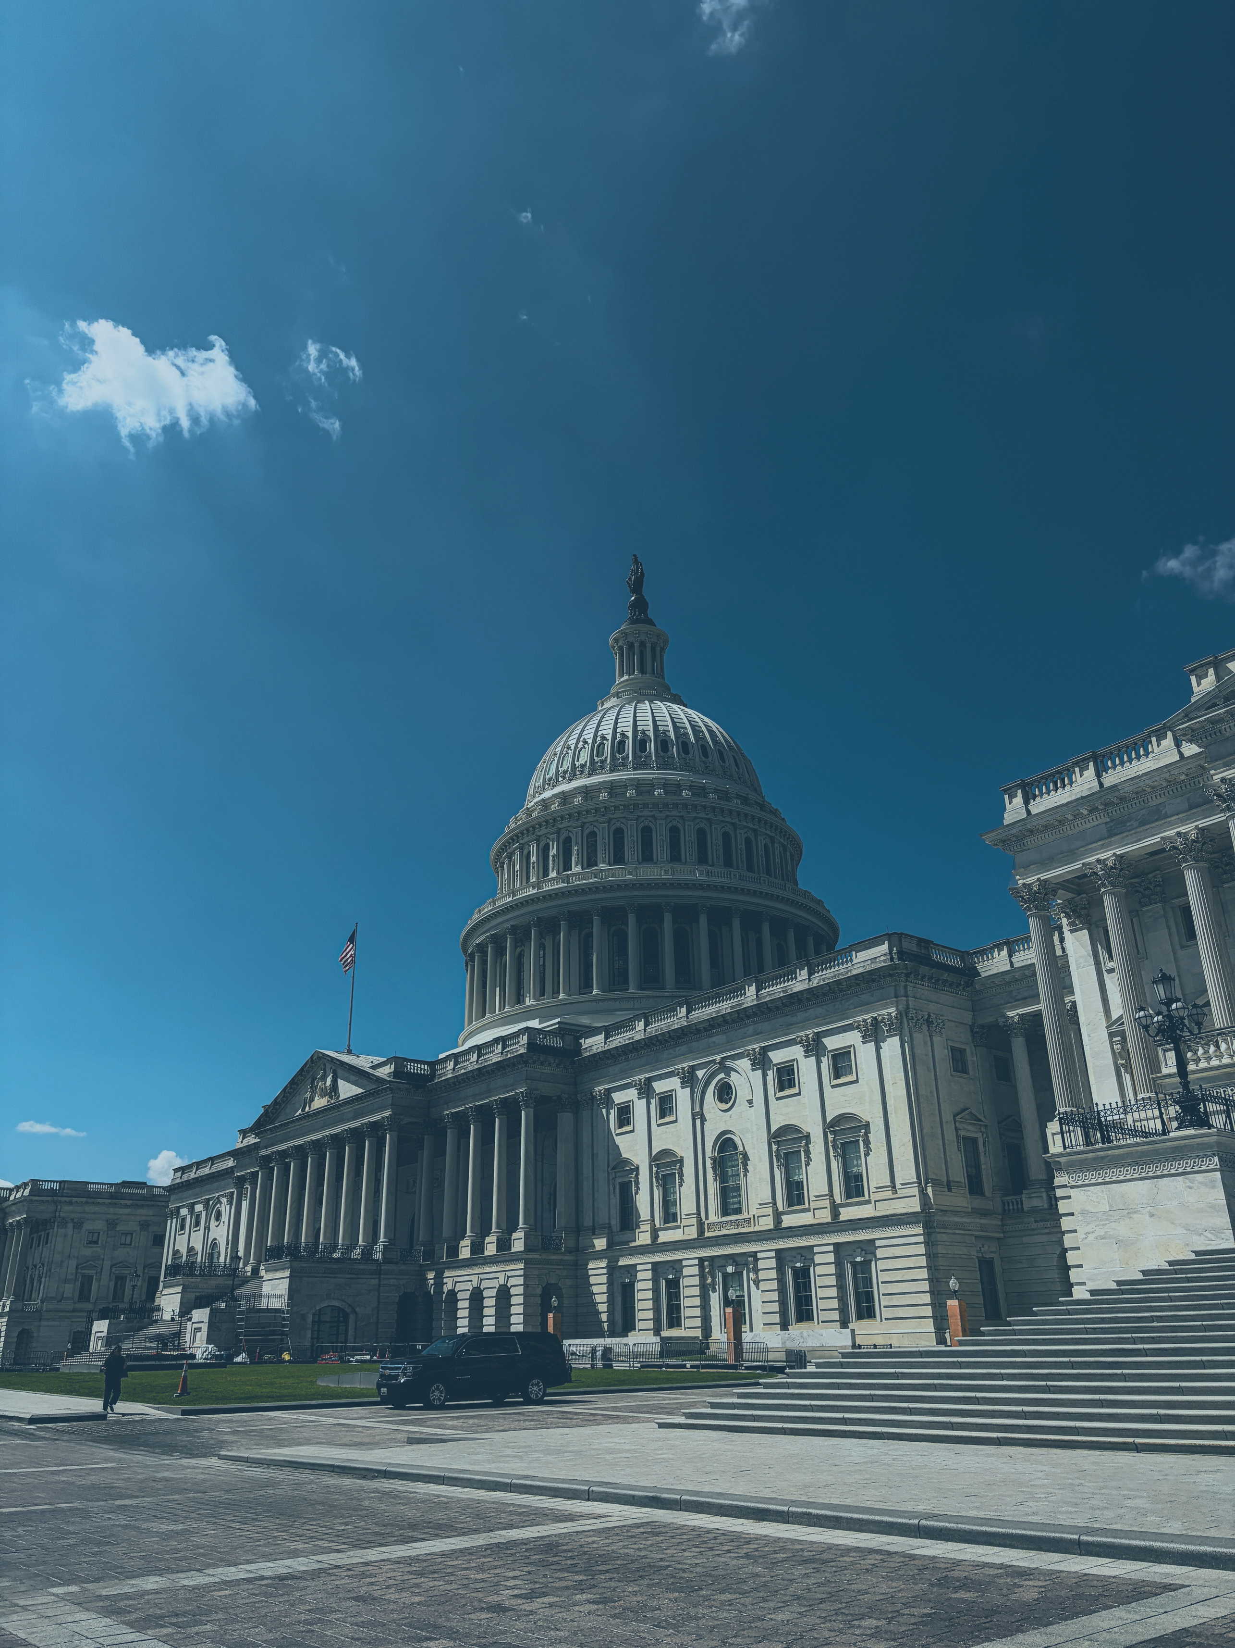




APA 2026 CONVENTION
Presented by Becky Weber of Prime Policy Group

Slide 2
APA ADVOCACY GOALS
    RECLASSIFICATION OF CONSUMER FIREWORKS TO ESTABLISH MAXIMUM PYROTECHNIC COMPOSITION LIMIT OF 500 GRAMS UNDER FEDERAL LAW AND CORRESPONDING CPSC REGULATIONS
    INCREASING ENFORCEMENT OF ILLEGAL IMPORTATION OF FIREWORKS
    REDUCING TARIFFS ON ALL CLASSIFICATIONS OF FIREWORKS

Slide 3
MIDTERM ELECTIONS
32 DAYS AWAY
    Historically, the party out of power in the White House GAINS seats in a mid-term election
    Only two exceptions in history where this has not occurred
    This year has the highest number of House Members not seeking re-election in history

Slide 4
MID-TERM ELECTIONS
    Unprecedented mid-decade redistricting efforts have succeeded in 9 States.
    Alabama, California, Florida, Louisiana, North Carolina, Ohio, Tennessee, Texas, and Utah
    As of today, the redistricting gives Republicans a net national edge of ~7-9 additional potential seats in the fight for the House.

Slide 5
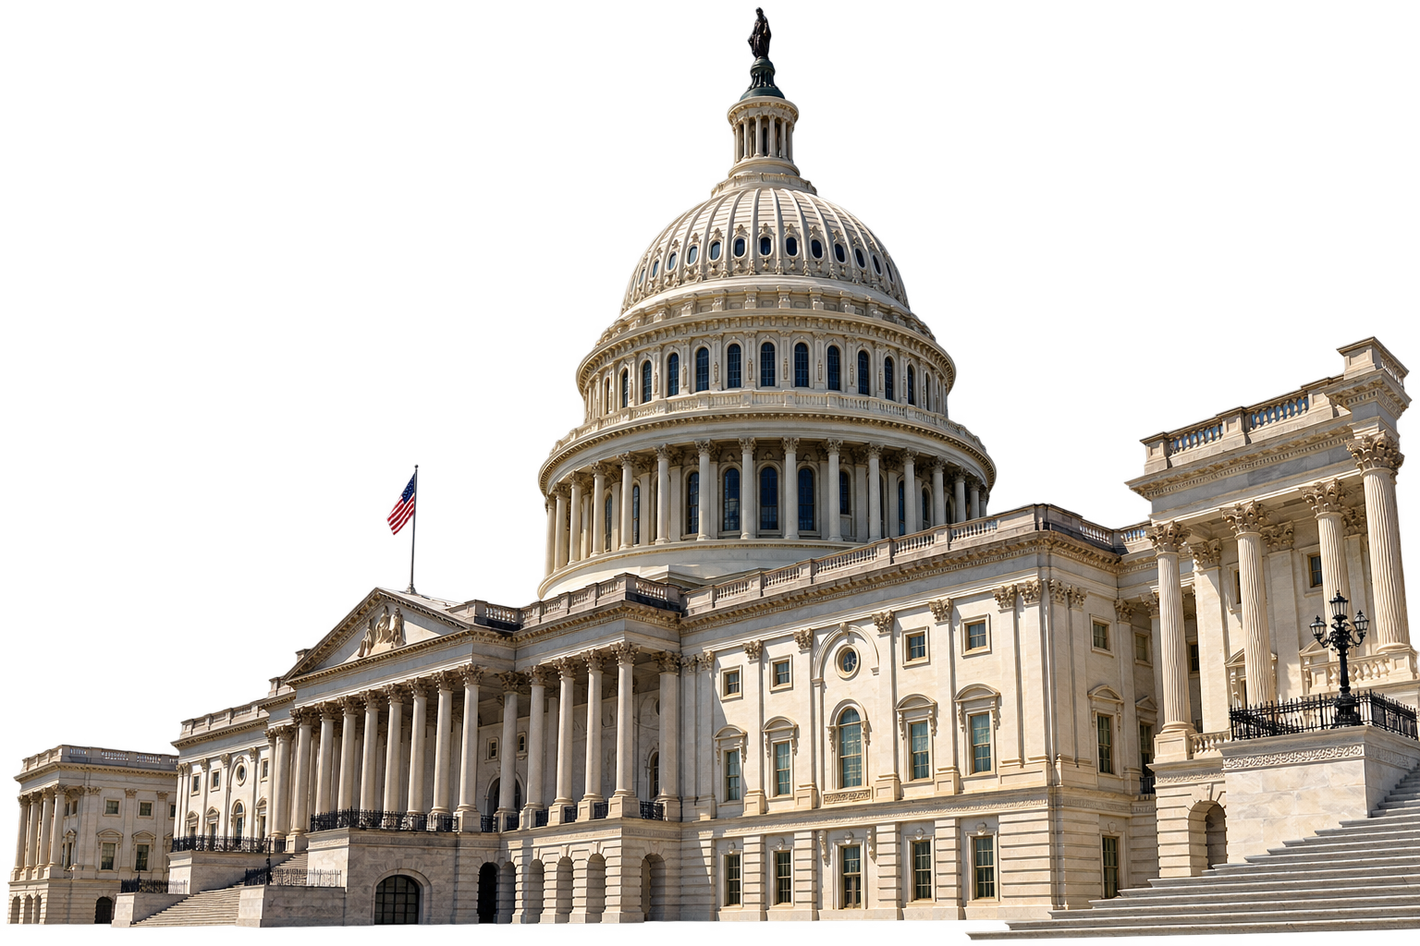
SENATE
    Current party split: 53 Republicans – 47 Democrats or Independents
    35 seats are contested
    Democrats need a net gain of 4 seats to have a Majority

Slide 6
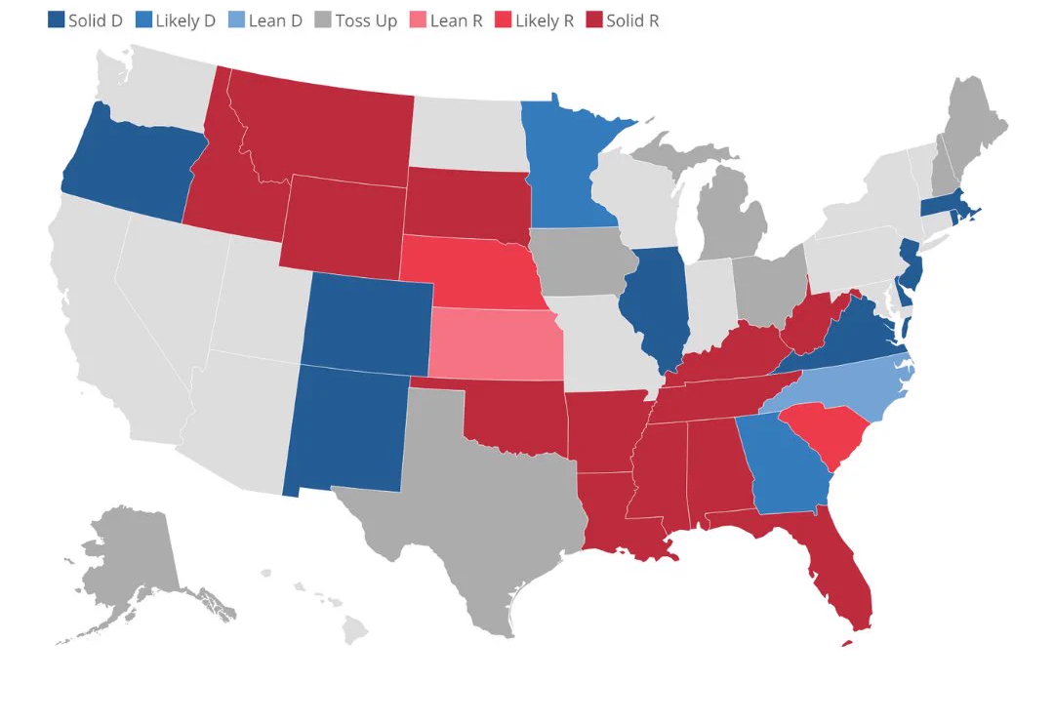
BATTLEGROUND SENATE RACES

Slide 7
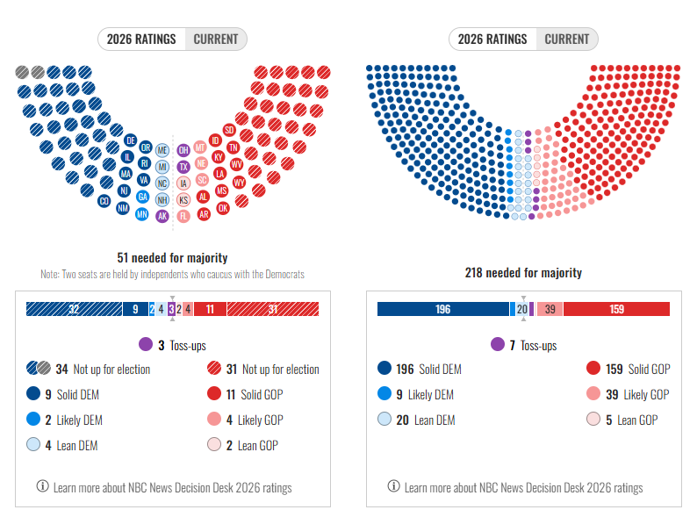
CURRENT POLLING

Slide 8
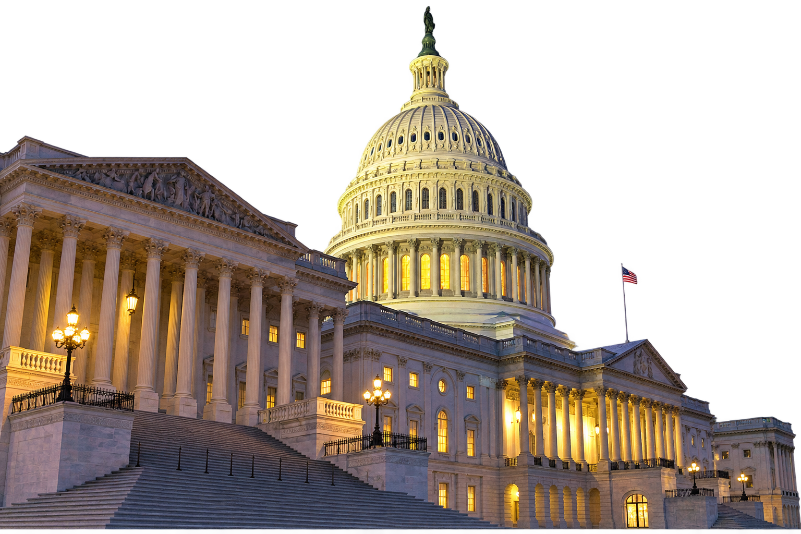
HOUSE OF
REPRESENTATIVES
    Current party split:
      219 (218 Republicans and 1 Independent) – 214 Democrats
    Currently two vacancies:
      Rep. Sheila Cherfilus-McCormick (D-FL) – Resigned
      Rep. Tony Gonzalez (R-TX) – Resigned
    Full House is 435 – Majority is 218
    ~21 Battleground Races

Slide 9
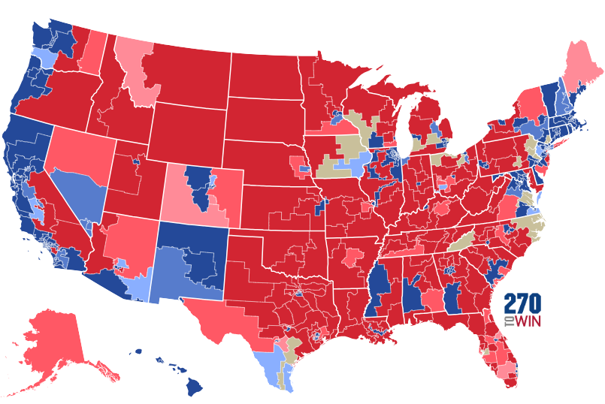
BATTLEGROUND HOUSE RACES
WA-3
WI-3
MI-7 & MI-10
PA-7 & PA-10
CO-8
NY-17
NJ-7 & PA-8
IA-1 & IA-3
OH-7 & OH-9
CA-22
VA-2
AZ-1 & AZ-6
FL-14
TX-34
FL-25

Slide 10
CURRENT POLLING

Slide 11
ELECTION OUTLOOK
Major Issues for Voters
  Economy: Gas, diesel, groceries, and energy prices are high. Tariffs and ongoing trade wars are also major topics.
  Healthcare: Cuts to Medicare and Medicaid, drug pricing, food contamination, vaccines, and the Make America Healthy Again movement are among top concerns for voters in this election cycle.
  Immigration: Immigration remains a major issue for voters, especially Republicans.
  National Security: 69% of Americans disapprove of the War in Iran. Russia-Ukraine War, competition with China, and the crises in Gaza and the West Bank influence voter decisions.
  AI & Data Centers: 71% of Americans oppose data centers. Whistleblowers from AI companies have raised alarms for restrictions on development.

Slide 12
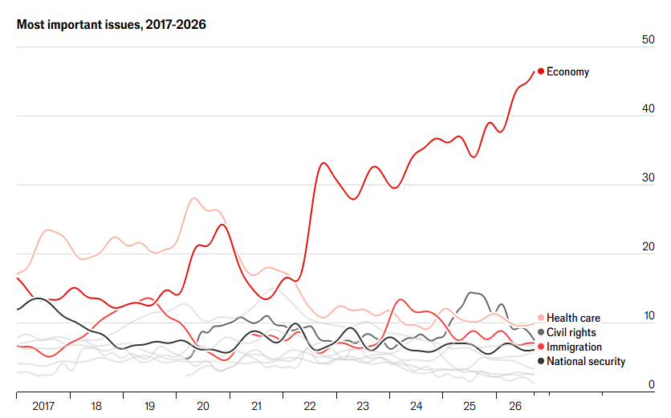
  The Economist, September 22nd, 2026

Slide 13

MID-TERM ELECTIONS
PRESIDENT TRUMP
    Officially not on the ballot, but de facto, will be on every ballot
    Presidential approval numbers have been steadily going down since February of 2025, currently averaging around 35%
    The President is currently losing Independent voters
    Still plays a big role by endorsing or opposing Congressional candidates and bringing out the base

Slide 14
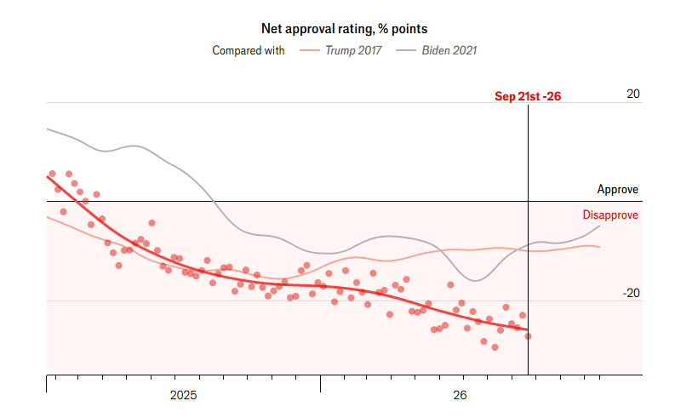
  The Economist, September 22nd, 2026

Slide 15
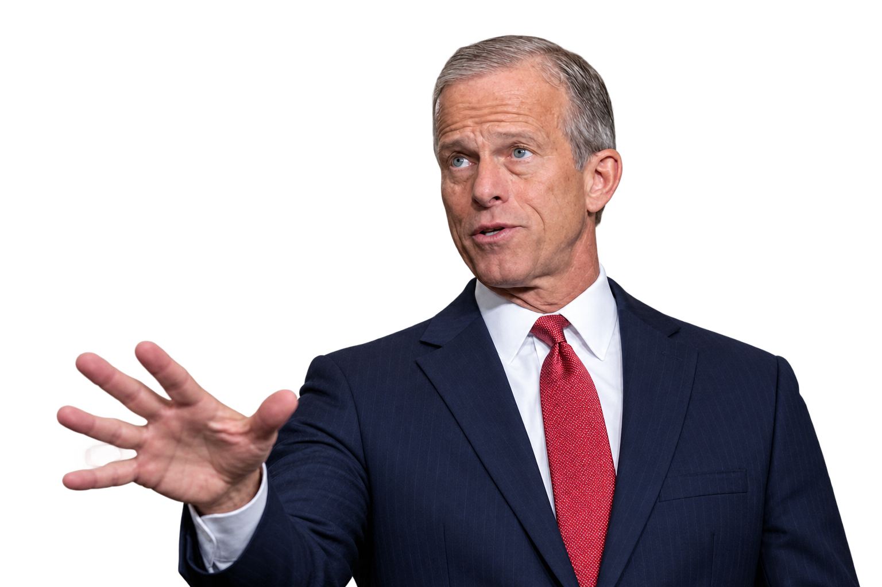
IF REPUBLICANS KEEP THE SENATE MAJORITY
    Senate Leader: John Thune (SD)
    Commerce, Science, & Transportation: Ted Cruz (TX)
    Environment & Public Works: Shelley Moore Capito (WV)
    Judiciary: Mike Lee (UT)
    Appropriations: Susan Collins (ME)

Slide 16
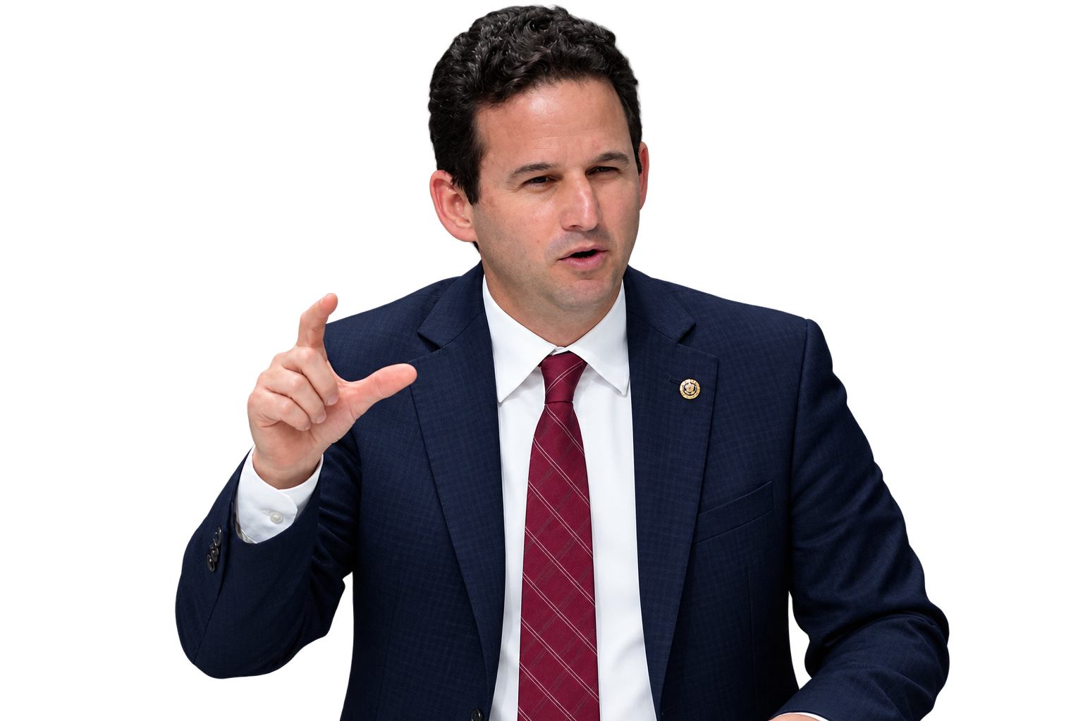
IF THE SENATE FLIPS TO A DEMOCRAT MAJORITY
    Senate Leader: Brian Schatz (HI)
    Commerce, Science, & Transportation: Maria Cantwell (WA)
    Environment & Public Works: Jeff Merkley (OR)
    Judiciary: Sheldon Whitehouse (RI)
    Appropriations: Patty Murray (WA)

Slide 17
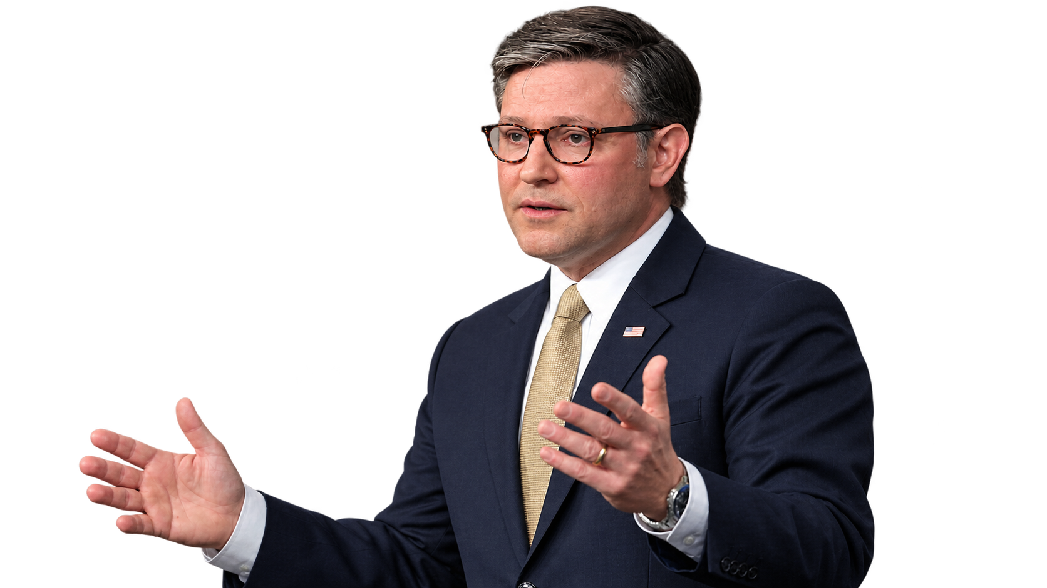
IF THE HOUSE RETAINS A REPUBLICAN MAJORITY
    Speaker: Mike Johnson (LA)
    Energy & Commerce: Brett Guthrie (KY)
    Transportation & Infrastructure: David Rouzer (NC)
    Judiciary: Laurel Lee (FL) or Scott Fitzgerald (WI)
    Appropriations: Tom Cole (OK)

Slide 18
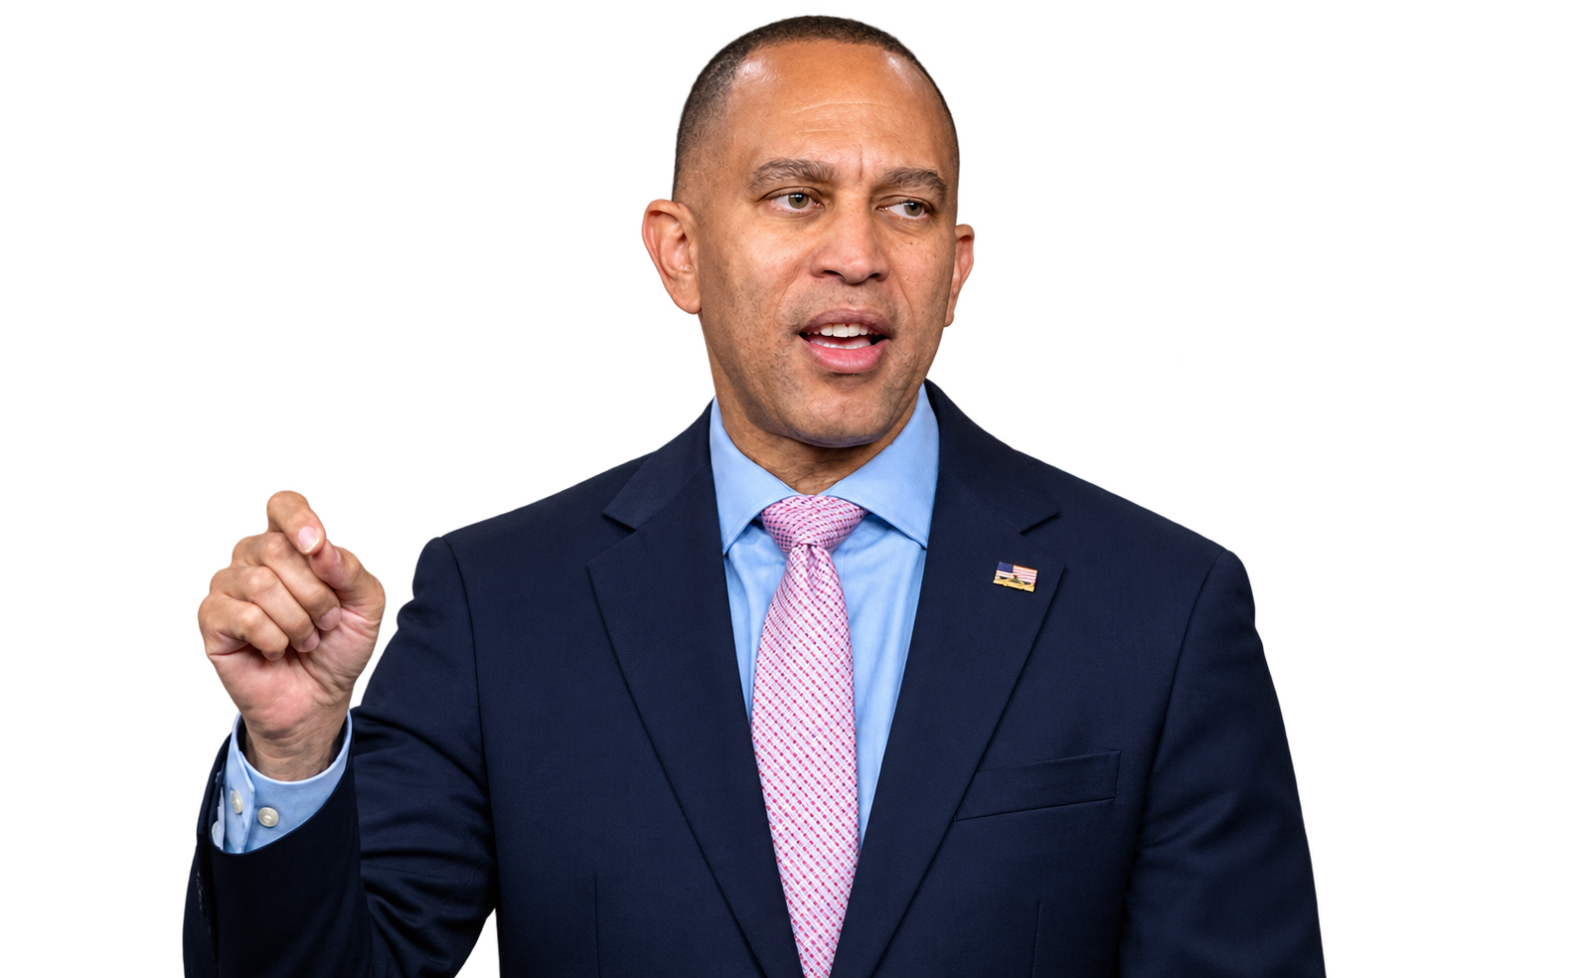
IF THE HOUSE FLIPS TO A DEMOCRAT MAJORITY
    Speaker: Hakeem Jeffries (NY)
    Energy & Commerce: Frank Pallone (NJ)
    Transportation & Infrastructure: Rick Larsen (WA)
    Judiciary: Jamie Raskin (MD)
    Appropriations: Rosa DeLauro (CT)

Slide 19
OUR SEPTEMBER
PREDICITIONS
    HOUSE
    Despite redistricting giving a slight edge to Republicans, chamber appears likely to flip to Democrat control
    Likely a narrow majority; no huge wave
    100 Day Plan – Investigations, investigations, investigations
    SENATE
    As of today, ~54% chance Senate flips to Democrat control
    If it stays Republican it will act as a check for the House. If it flips Democratic, it will be investigations and impeachment.

Slide 20
DEMOCRATS’ FIRST 100
DAYS PLAN
    Five Working Groups: Lowering costs for housing, healthcare, childcare, groceries, gas, and utilities
    Healthcare: Reversing Medicaid cuts and reviving expired Affordable Care Act (ACA) tax credits
    Federal Agency Oversight and Accountability: Committee chairs, budgets, appropriations, subpoena authority to do investigations
    Restoring Congressional authority over tariffs and certain executive actions
    Campaign finance, voting rights, and government ethics reforms
    Impeachment of agency officials and the President

Slide 21

THANK YOU!
BECKY WEBER
MANAGING DIRECTOR
PRIME POLICY GROUP

