Slide 1
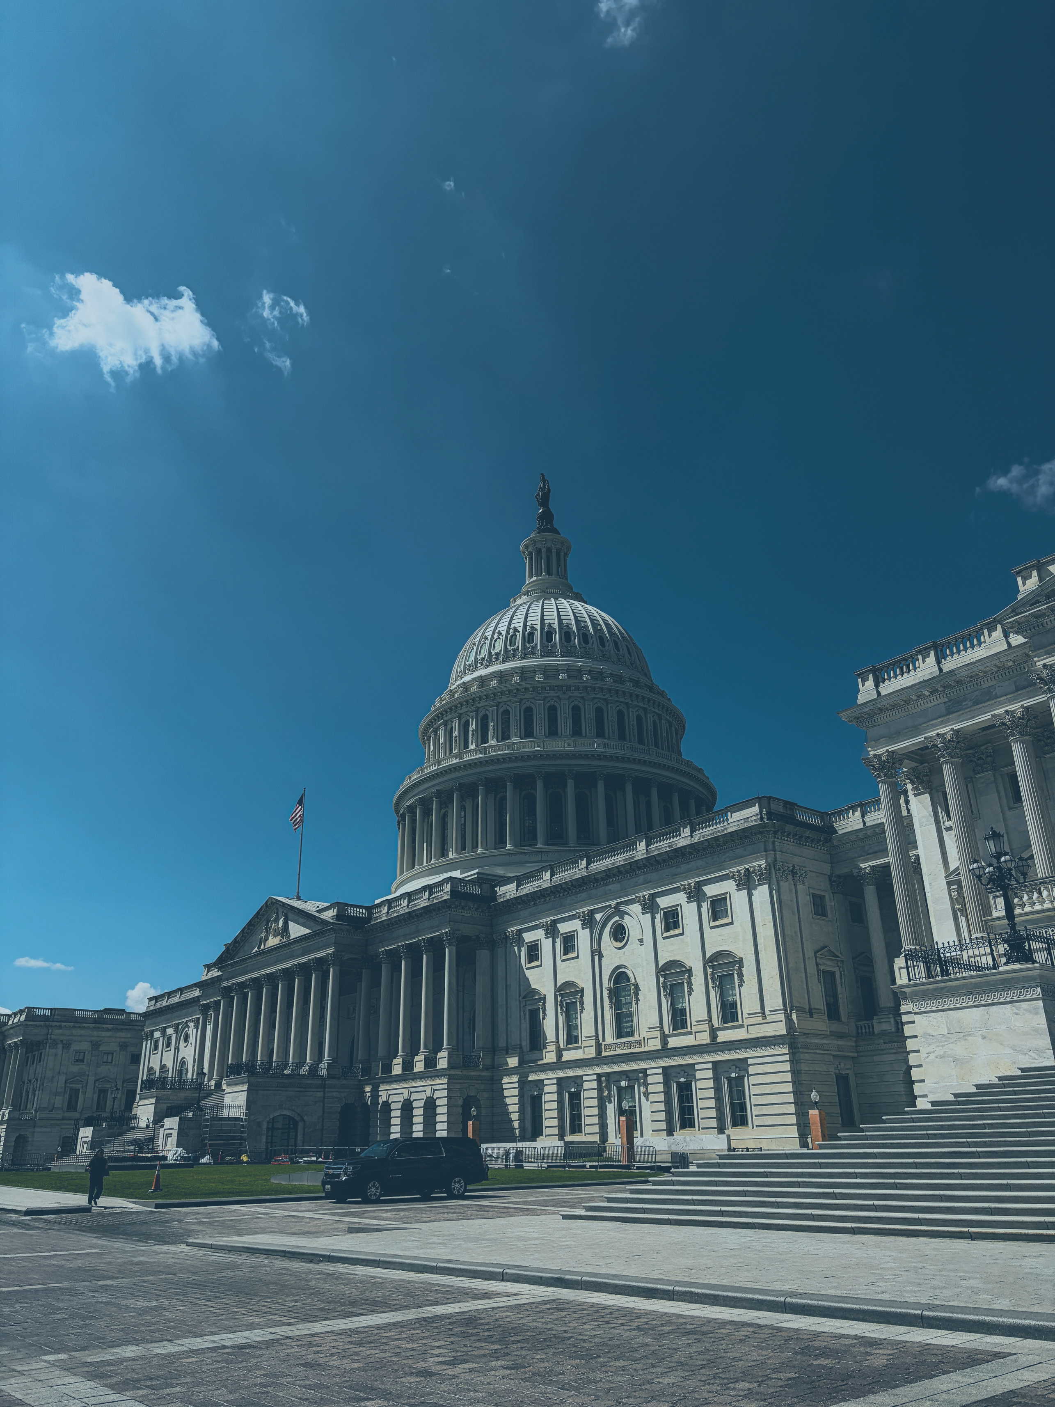




TRADE
Presented by Casie Daugherty of Prime Policy Group

Slide 2
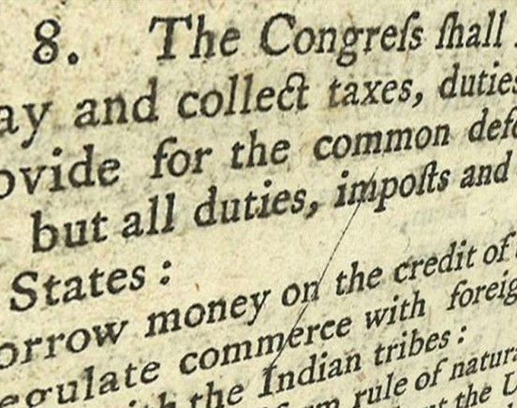
TARIFF AUTHORITY
Smoot-Hawley Tariff Act of 1930
  Section 338
Reciprocal Trade Agreements Act of 1934
Trade Expansion Act of 1962
  Section 232
Tariff Act of 1973
  Section 301
International Emergency Economic Powers Act of 1977

Slide 3
TARIFFS 101
Original China tariffs from Trump 1.0
Section 232 Tariffs
Sector-specific
Section 301 Tariffs
Section 338 Tariffs
Currently only targeting Canada
Applied globally unless a country negotiates a carve-out
50% tariffs with import bans on some products (alcohol, motorcycles, dairy whey, etc.)
Numerous investigations complete, more likely coming
Shipbuilding and Maritime Investigation (currently delayed until November)
Forced Labor
Excess Capacity (still pending)

Slide 4
CURRENT STATE: CHINA TARIFFS
  IEEPA Tariffs (overturned by U.S. Supreme Court) and Sec. 122 Tariffs (expired July 24) are no longer in effect
  As part of their effort to rebuild their “Tariff Wall,” the Administration levied 12.5% tariffs on Chinese imports as of July 24, 2026 as a result of a Sec. 301 investigation into Forced Labor
  Pending Tariffs:
      Sec. 301 on Shipbuilding & Maritime (1-year delay expires Nov. 9)
      Sec. 301 on Excess Capacity (rate likely 7.5 – 30%)
      Russia Sanctions/Oil Purchase Tariffs (unknown)

Slide 5
US – CHINA MEETING
  What We Know
  The U.S. and China announced a 2-month extension of the “trade truce” that went into effect in November 2025. It will now expire January 10, 2027
  The U.S. and China released lists of products as part of a 30-for-30 deal
  What We Don’t Know
  Does the trade truce extension include everything that was part of the original deal?
  Are the pending trade investigations and other potential tariffs subject to the truce?

Slide 6
30-For-30 Trade Deal
  U.S. China Board of Trade
  The U.S. and China have created a Board of Trade to help manage the trading relationship between the two countries
  The Board’s first act was to release two lists of “non-sensitive” goods that could be eligible for reduced tariff treatment
  HTSUS code 3604.10.90 (Fireworks, nesoi) is the first product listed
  However, other fireworks codes are not listed. These include:
      3604.10.10: Fireworks, Class 1.3G UN0335 (Display Fireworks)
      3604.90: Articles, Pyrotechnic Class 1.4G UN0431
      3604.90.0000: Snappers & Poppers

Slide 7
30-For-30 Trade Deal
  Unknowns outnumber known details
  The announcement was very sparse on necessary details for importers and consumers.
  What we still don’t know includes:
      Timeline for implementation
      Potential new tariff rates
      How products can be nominated for Board of Trade consideration
      If inclusion on this list excludes products from other tariffs
  When Will We Know?
  The short answer is:

Slide 8
OUR WORK CONTINUES
  Tariff Priorities
  Ensure quick implementation of the 30-for-30 deal for consumer fireworks, pushing for tariff-free treatment
  Push for inclusion of commercial-grade fireworks as part of the deal or as the first products included in the next list
  Carve out fireworks from tariffs resulting from Sec. 301 excess capacity investigation
  Prevent tariffs on fireworks if Administration takes action to punish China as a purchaser of Russian oil

