Slide 1
APA Conference PHMSA Updates
Steven Andrews, Acting Senior Regulations Officer │ Standards and Rulemaking Division │ September 2026

Slide 2

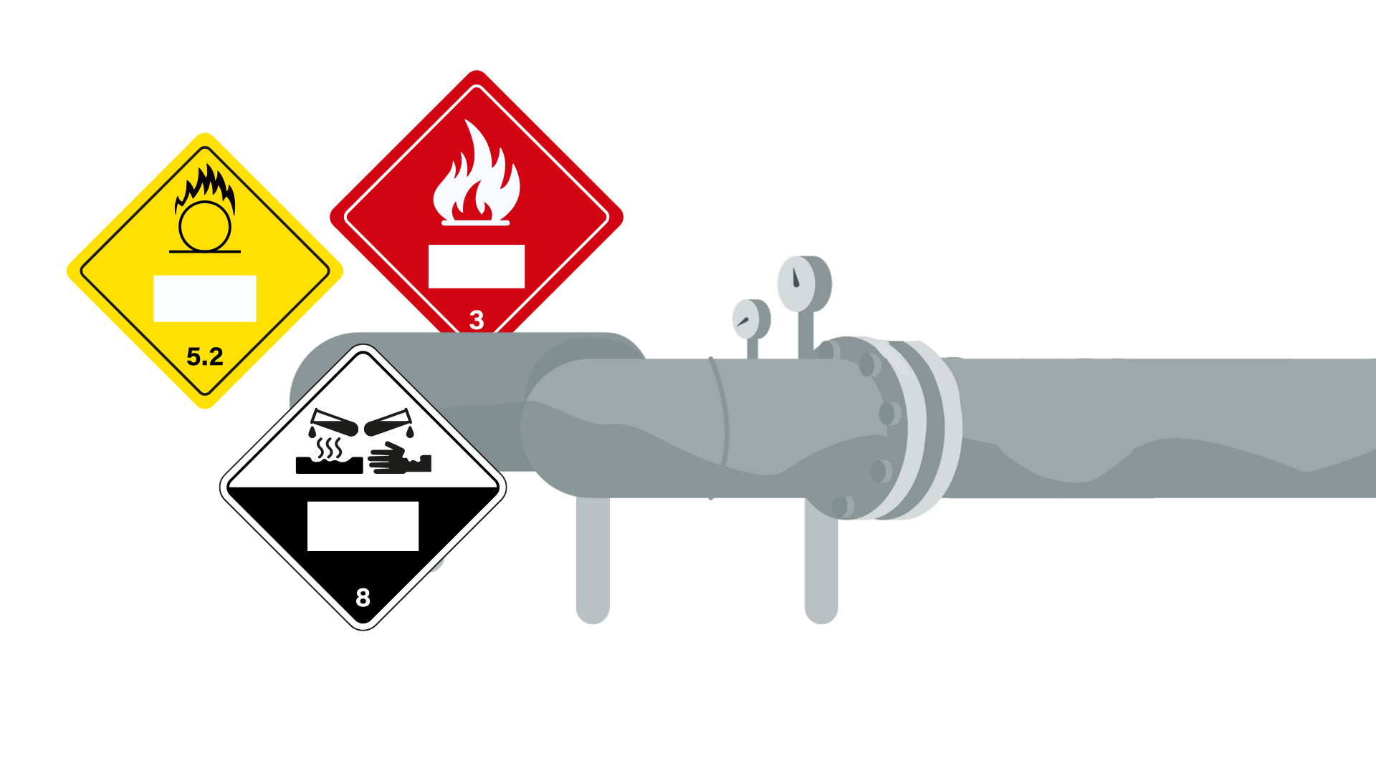
HM-257A Final Rule
PHMSA published the HM-257A Final Rule “Streamlining Requirements for the Approval of Certain Energetic Materials” on June 2, 2026
Final rule became effective on July 2, 2026
Final rule has a delayed compliance date of August 31, 2026

Slide 3

PHMSA Portal
The End of Paper: Paper and email application submissions are strictly a thing of the past for PHMSA.
Benefits: It drastically enhances PHMSA’s ability to track applications, completely prevents submissions from getting "lost in the mail," and significantly accelerates initial processing

Slide 4

Novelty Exceptions
Codifying the Rules: Adopts long-standing guidance directly into the HMR framework.
Clear Exceptions: Low-hazard novelty devices explicitly excepted from strict regulation provided they meet specific criteria.

Slide 5

Self Certification of Low-Hazard Ground Fireworks
Bypassing the Bottleneck: Self-certifying specific, eligible low-hazard ground fireworks.
Time-to-Market: The traditional administrative bottleneck is gone.

Slide 6

HM-268(A-Q) – Deregulatory Final Rules​
HM-268A – Aerosol definition harmonization
HM-268B - Resized limited quantity marking
HM-268C – Expanded MOTs for lithium batteries
HM-268D – Electronic Emergency Response Info
HM-268E – Referencing EPA hazardous substance list
HM-268F – Allowing the use of expired MMS permits
HM-268G – Eliminating 60-day renewal requirement for special permits

Slide 7
HM-268(A-Q) – Deregulatory Final Rules​
HM-268H – Removal of paper checks for registration
HM-268I – Electronic registration information
HM-268J – Security awareness training for Farmers
HM-268K – Obsolete rail requirements
HM-268L – Incorporation of special permits for unloading IBCs and portable tanks
HM-268M – Incorporation of special permits for transporting small refrigerating machines

Slide 8
HM-268(A-Q) – Deregulatory Final Rules​
HM-268N – Incorporation of special permits for large refrigerating machines
HM-268O – Incorporation of special permits for UE examination of DOT 3A/3AA cylinders
HM-268P – Incorporation of special permit for transportation of IBCs containing residues
HM-268Q – Approval of professional fireworks by FCAs

Slide 9

Final Rules
Final Rulemakings
HM-215R – International Harmonization
HM-265C - Advancing Safety of Highway, Rail, and Vessel Transportation

Slide 10



Notice of Proposed Rulemakings
Open Rulemaking Actions Con’t…
HM-215S – Harmonization with International Standards
HM-219E – Modernizing Regulatory Requirements and Responding to Stakeholder Petitions​
HM-233G – Continued Conversion of Special Permits
HM-267 – Modernizing Regs to Facilitate Transportation of Spacecraft and Space Related Hazmat​

Slide 11

Notice of Proposed Rulemakings
Open Rulemaking Actions Con’t…
HM-266 – Modernizing Regs to Facilitate Transportation of Hazmat Using Highly Automated Transportation Systems

Slide 12
Advance Notice of Proposed Rulemakings
Open Rulemaking Actions Con’t…
HM-224J – Improving Safety of Transporting Damaged, Defective, or Recalled Lithium Cells or Batteries

Slide 13

American Pyrotechnics Association (APA)
Petitions for Rulemaking
P-1802 – Incorporation by Reference of updated APA Standards APA 87-1A and 87-1C
Date of Petition: 4/47/2025
Acknowledgment Letter: 4/30/2025
Response Letter: 9/2/2025

Slide 14
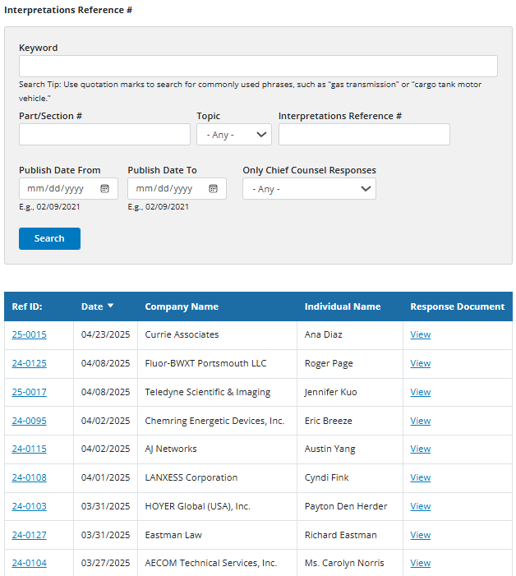

Enhanced Transparency of Interpretation Process
In 2025, PHMSA implemented the 30-day pending interpretation process to modernize how it provides regulatory guidance. The change was driven by two primary goals: transparency and stakeholder engagement. URL LINK HERE
How the Process Works
Initial Review: PHMSA conducts a preliminary review of an incoming LOI request.
Public Posting: The request is posted to a "Pending" page on the PHMSA website (separated into Pipeline and Hazmat sections).
30-Day Window: Stakeholders have 30 days to submit comments via a "Submit Comment" link.
Final Decision: PHMSA reviews the comments and then issues a final, written interpretation or denies the request.

Slide 15

Training and Outreach
Quarterly Hazardous Matters Newsletter
Multi Modal Seminar (Frisco, XT)
  October 21-22, 2026
Updating Guidance Documents
Upcoming Webinar
  “How to use the Hazardous Materials Table”
  September 30, 2026 at 1:00 CST

Slide 16








Thank you

