Slide 1

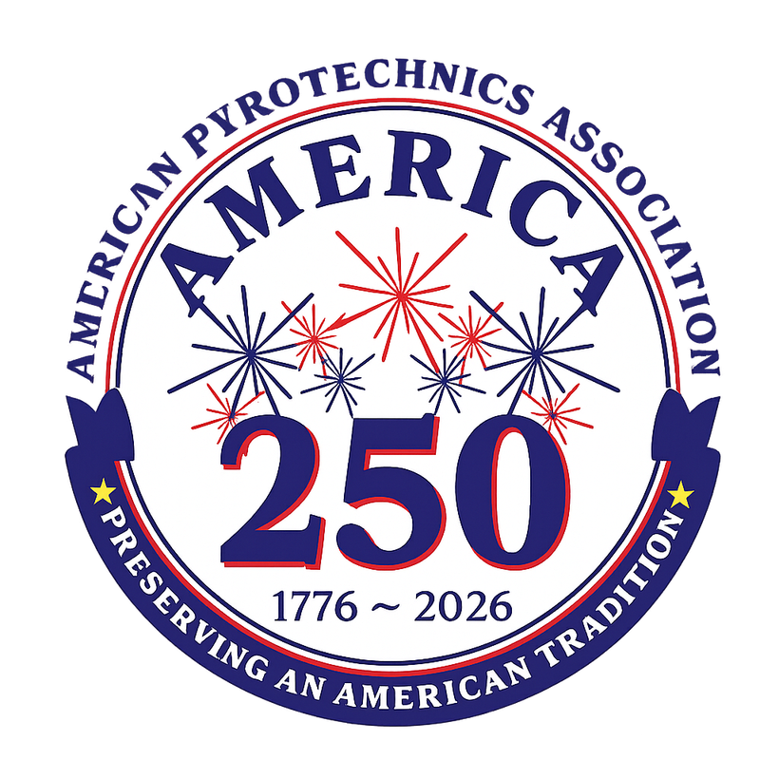
Display Industry Forum
Proximate Pyrotechnics Committee Update.
Chair- Brian Panther

Slide 2
Key Committee Activities
APA- 87-1 Update- IBR Petition accepted by PHMSA- Waiting for publishing in the Federal Register as NPRM.
Final Rule published by PHMSA allowing FCA- Approvals for 87-1C applications.

Slide 3
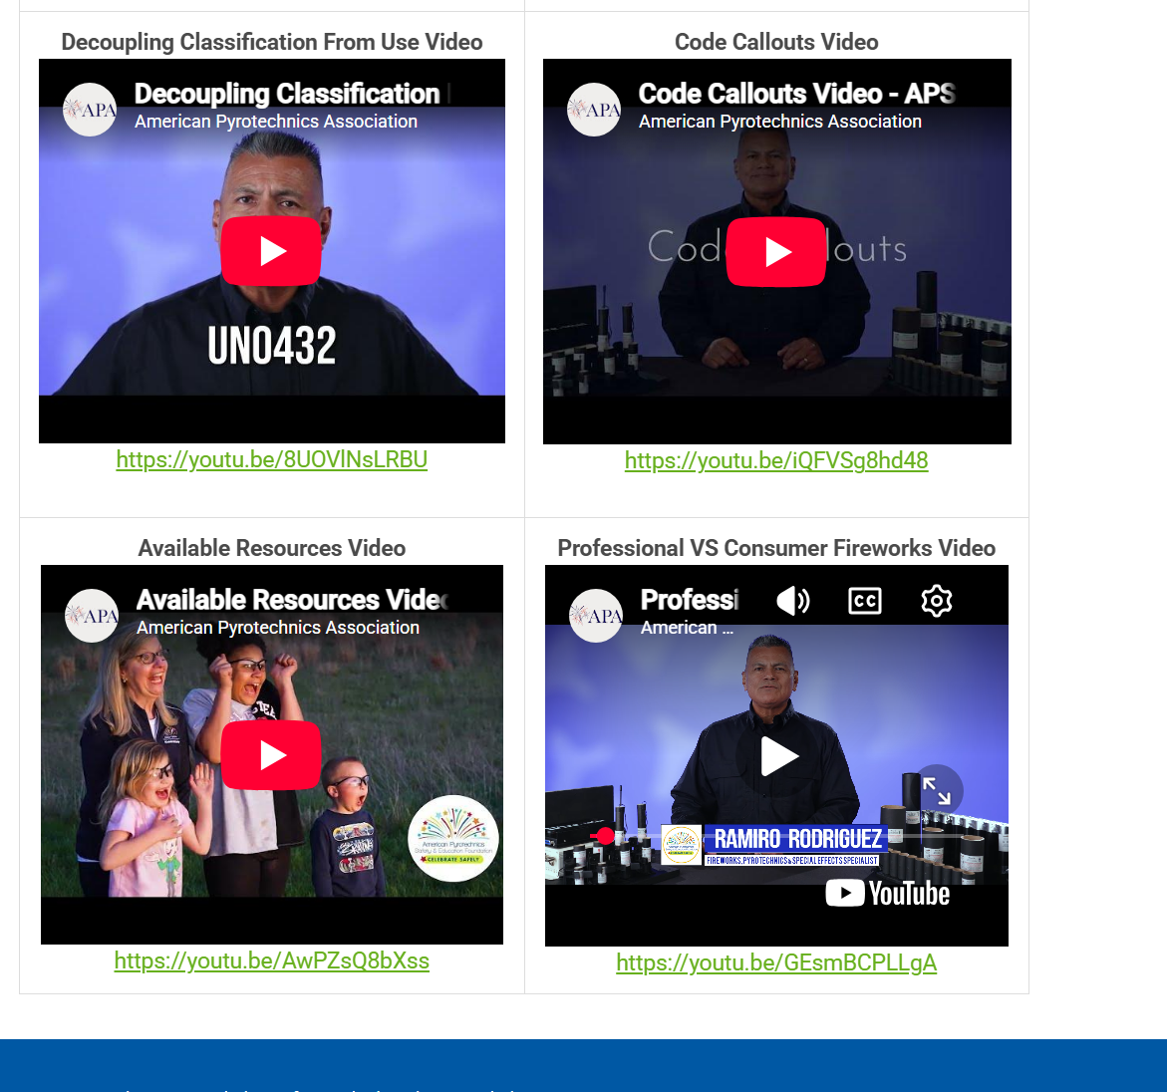
Prox Video Safety Series Update
OVER 600 unique views:
Corporate Safety Culture Video 60 views
Focus on Risk Assessment Video 65 views
Decoupling Classification From Use Video 79 views
Code Callouts Video 68 views
Available Resources Video 41 views
Professional vs Consumer Fireworks Video 171 views

Slide 4
Prox Video Safety Series Update
The committee and foundation
have requested another video addressing the use of pyrotechnic simulation equipment, bottle & food sparklers and other items incorrectly referred to as “Cold Spark” devices

Slide 5
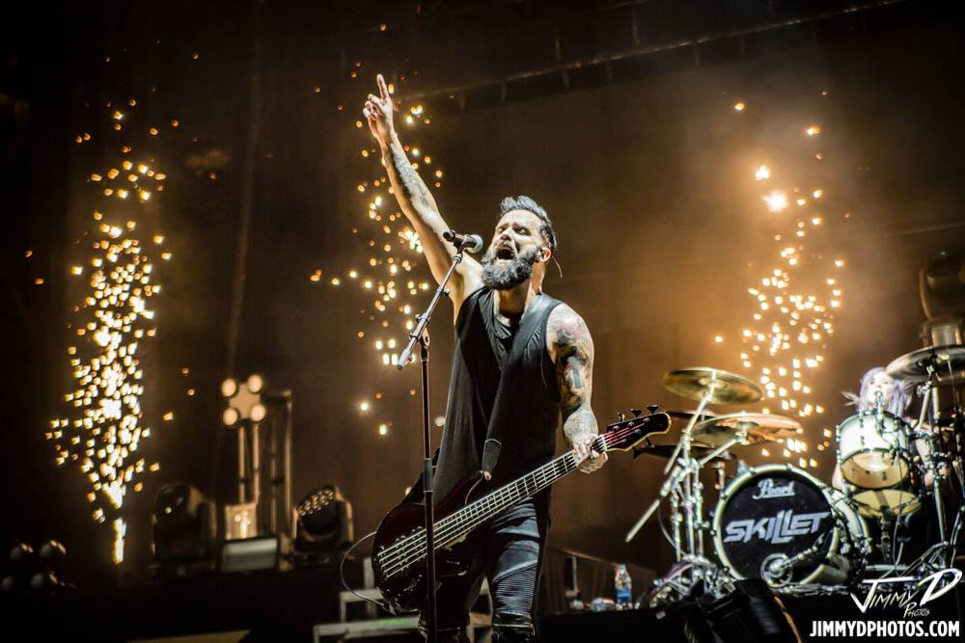
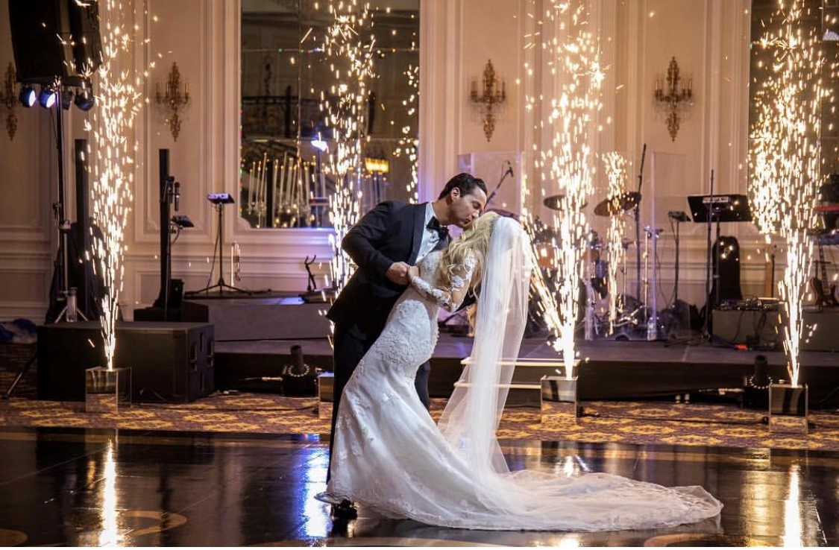
PYROTECHNIC SIMULATION EQUIPMENT
Popular in Clubs, Concerts, Hotel Ballrooms, Wedding Venues.

Slide 6
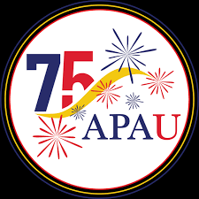
Update on APA-U Integration of Prox. training program
Work continues on the conversion of the Prox. training program into an LMS module for the APA-U Platform

Slide 7
Discussion on Possible Changes to Label on proximate devices
Ongoing discussions about the options of adding data to labels in a manner similar to the requirements for the EU
Possible discussion about adding more safety data to pyrotechnics plans required by 1126

Slide 8
Other new business:
Preliminary discussions on smoke by products from the use of proximate pyrotechnics.

Slide 9
Thank you!

