Slide 1



Slide 2
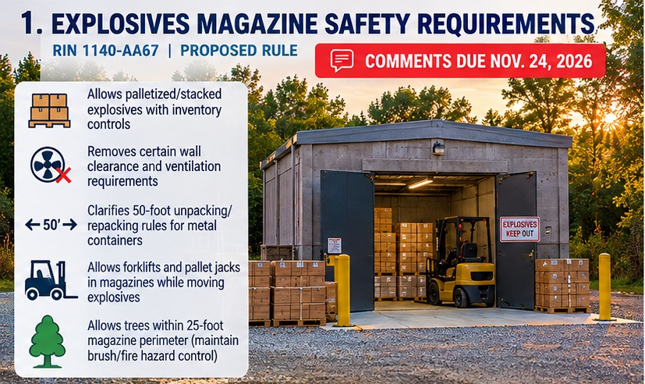

Slide 3


Slide 4
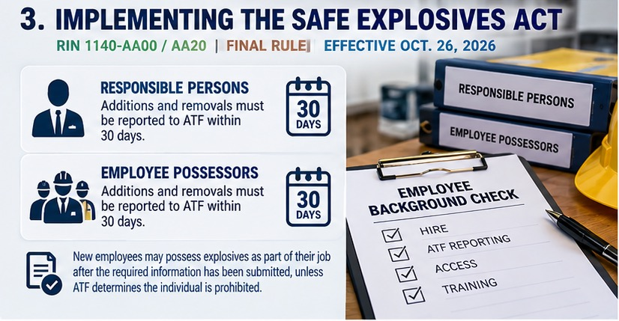

Slide 5
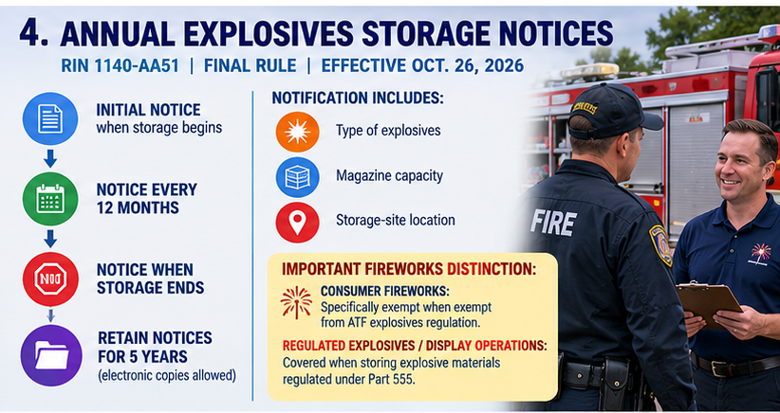

Slide 6
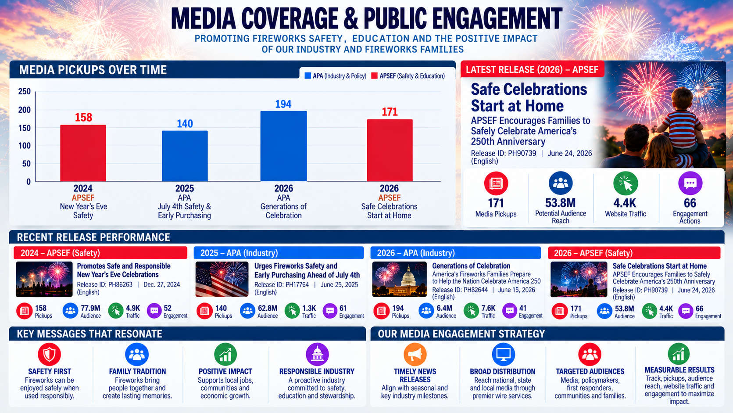

Slide 7
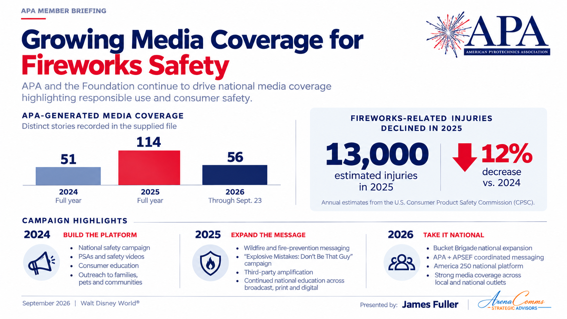

APA MEMBER BRIEFING
APA media coverage trends
Distinct stories recorded in the supplied file
2024
2025
2026
51
114
56
Full year
Full year
Through September 23
The latest 2026 item listed is dated September 12.
Selected inventory, not a census of all coverage. The partial 2026 period is not directly comparable with full years.
American Pyrotechnics Association · September 2026
07
Notes:
Source: supplied Julie_Heckman_APA_media_inventory_2024-2026 V1(1).xlsx, Overview tab. It lists 78 / 212 / 115 entries in 2024 / 2025 / 2026 and 51 / 114 / 56 distinct media stories after review. Some raw Excel date cells contain incorrect underlying years. Counts are presented from the reviewed Overview tab, not from recalculating raw rows.

Slide 8
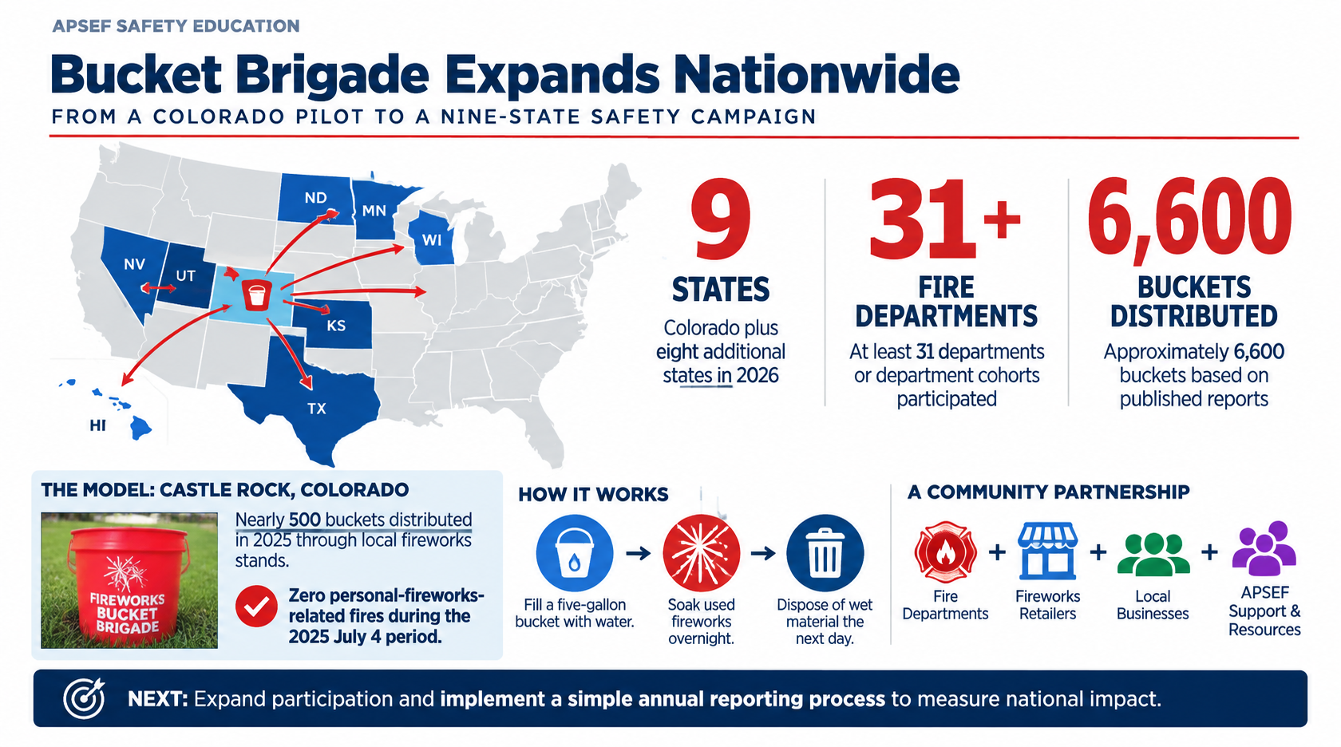
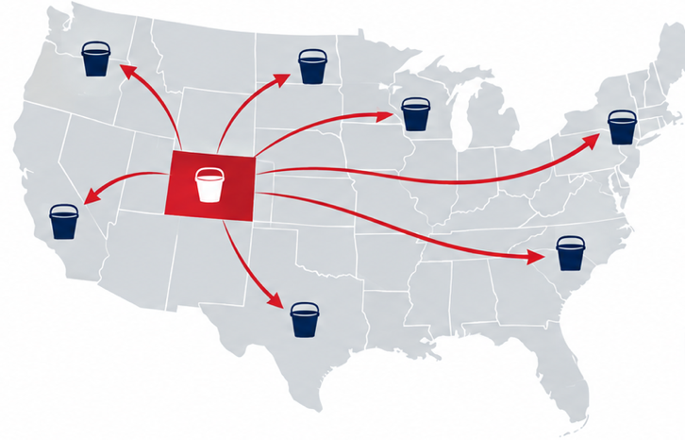
APSEF SAFETY EDUCATION
APSEF SAFETY EDUCATION
Bucket Brigade expands beyond Colorado
8
Additional states in 2026
Reported by the American Pyrotechnics Safety & Education Foundation
18
6
Nearly 2,000
Colorado departments formally adopted
additional departments replicated independently
buckets distributed statewide
American Pyrotechnics Association · September 2026
09
Notes:
Source: APSEF May 12, 2026 release https://www.prnewswire.com/news-releases/national-firework-safety-initiative-expands-ahead-of-250th-fourth-of-july-302769063.html and supplied APSEF expansion infographic. APSEF did not identify all eight additional states by name in the cited release, so this slide does not put markers on an unlabeled U.S. map. The 18 Colorado formal adoptions and six additional independent replications are distinct figures.

Slide 9
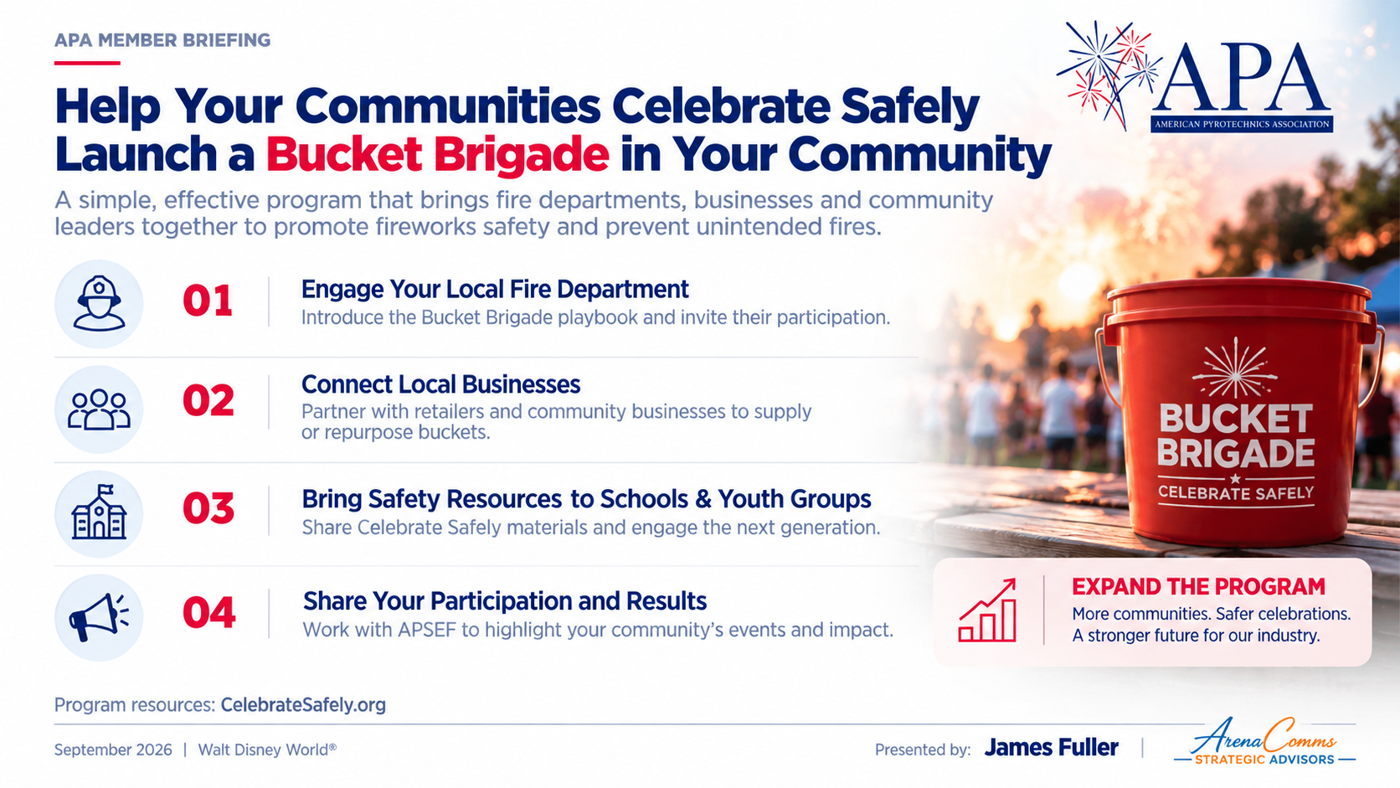

APA MEMBER BRIEFING
Help your communities celebrate safely
Launch a Bucket Brigade in your community
01
Introduce a local fire department to the Bucket Brigade playbook.
02
Connect businesses that can supply or repurpose buckets.
03
Bring Celebrate Safely resources to schools and youth groups.
04
Share participation and local results with APSEF.
Program resources: CelebrateSafely.org
SEPTEMBER 2026
11
Notes:
These are proposed member actions. APSEF provides the playbook and resources, and its May 12, 2026 release describes possible business, school and youth partnerships. Sources: https://www.americanpyro.com/safety-foundation ; https://www.prnewswire.com/news-releases/national-firework-safety-initiative-expands-ahead-of-250th-fourth-of-july-302769063.html .

Slide 10



Slide 11
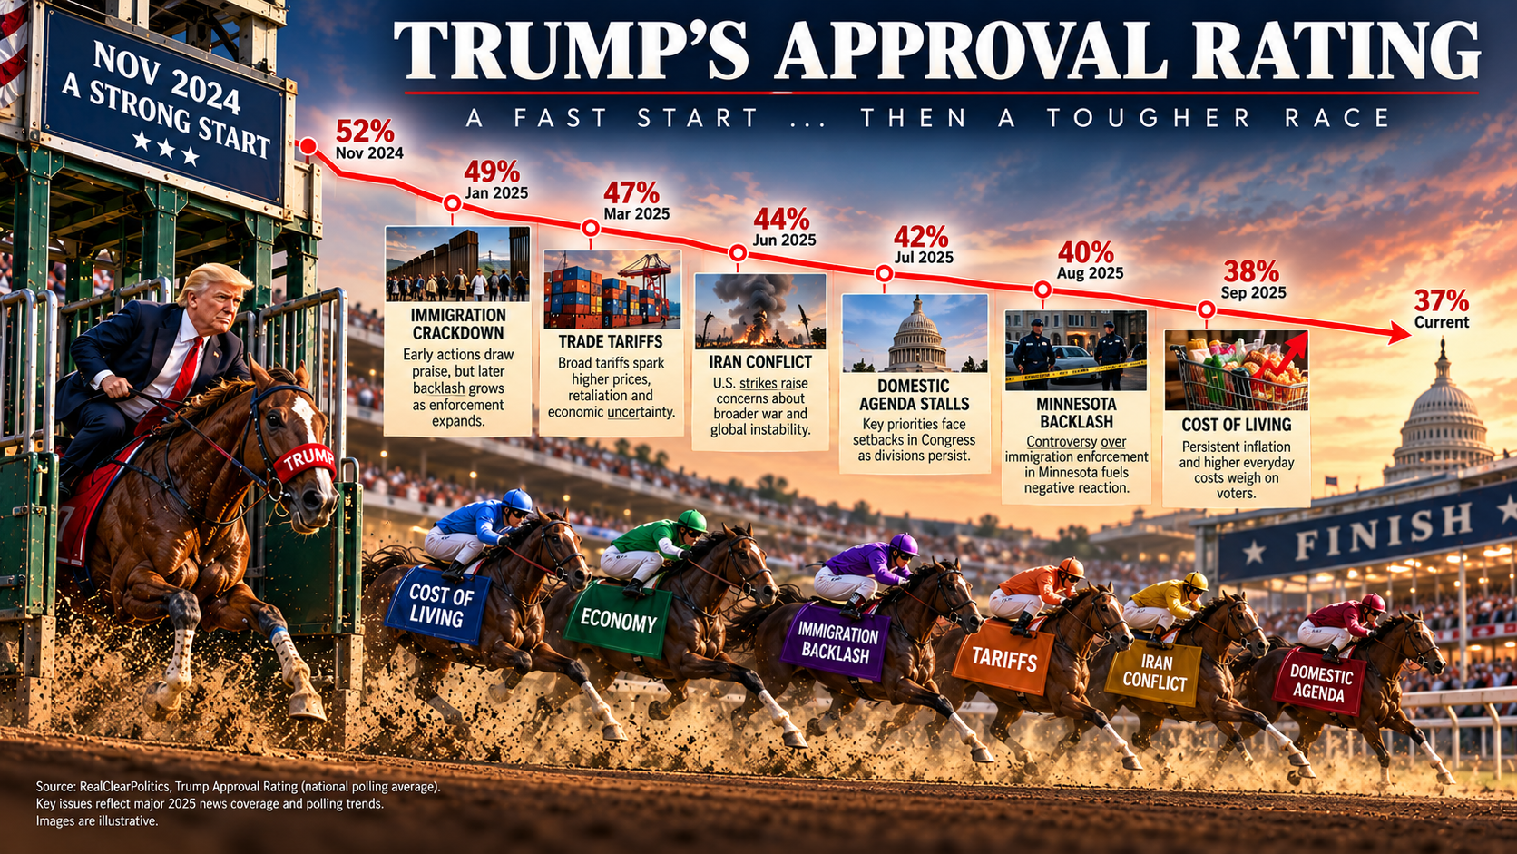

Slide 12
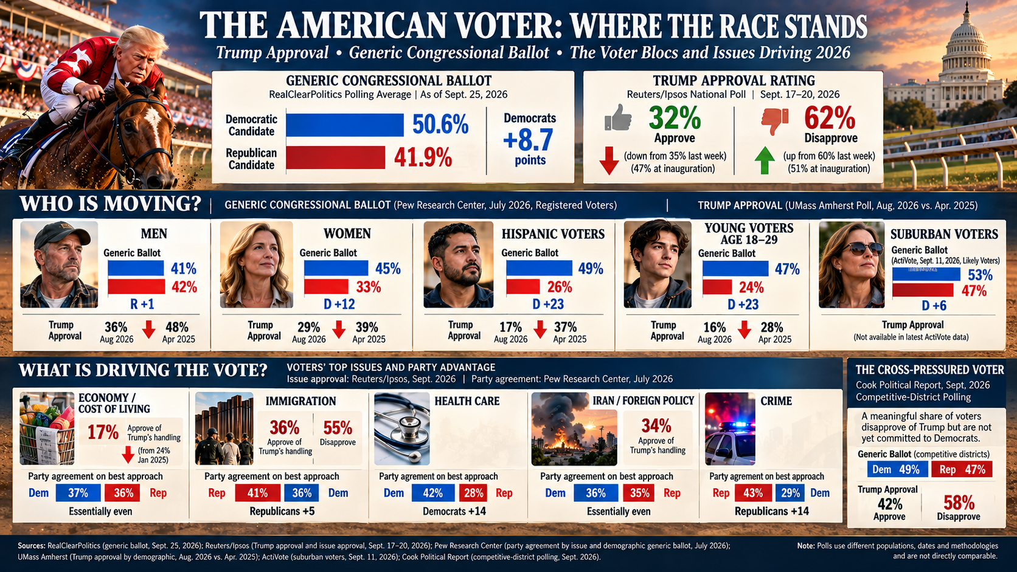

Slide 13
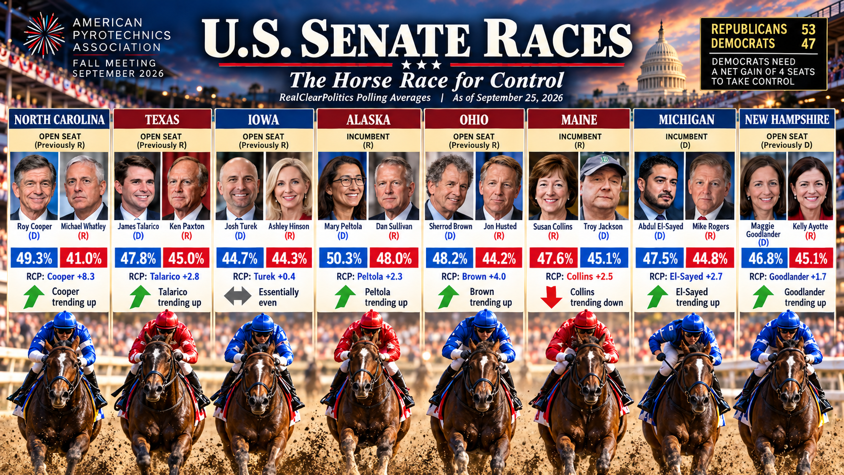

Slide 14


