Slide 1



APA
CONFERENCE
Industry Update
James Fuller
ArenaComms

Slide 2
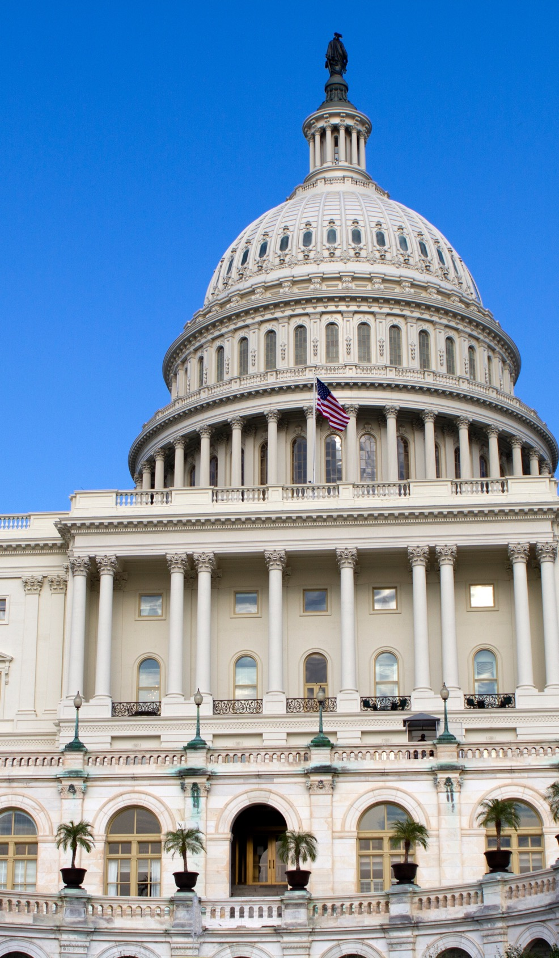

ATF Modernization
No public progress since our last conference
No exclusion language in the latest ATF appropriation bill
2

Slide 3

ATF Rulemaking Focus Remains
Licensing and permitting process
Definitions affecting classification
Recordkeeping
Shared magazine clarifications
Administrative streamlining

Slide 4
ATF FY2026 Funding Highlights
Total funding decreased by approx. $40M from last year
$1.625B FY2025
$1.585B FY2026
No statutory reduction in explosives division
No statutory language restricting ATF authority or jurisdiction

Slide 5
CPSC FY2026 Funding Highlights
Approximately $150.9M – Essentially flat from last year
No statutory reduction in compliance or enforcement
Continued focus on import surveillance and compliance over broad regulatory initiatives
Emphasis on data-driven risk targeting at POE
William “Billy” Hewes III nominated as commissioner

Slide 6


Fourth of
July
Preparations
America’s 250th

Slide 7
America 250 Opportunity
Unique moment to highlight the fireworks industry’s role in national celebrations, community traditions, and patriotic storytelling
Key Opportunities:
Showcase industry’s cultural importance across the country
Elevate member displays and community impact
Position APA as the central coordinating voice
Strengthen national media visibility

Slide 8
America 250 Celebration Map
Interactive digital map highlighting major celebrations and displays nationwide for both consumers and media
Approach:
Members submit major shows
Embedded event pages and program details
Highlight geographic diversity and locations of historic importance
Promote unique patriotic storytelling events
Innovation in presentation

Slide 9
The Nation’s Top Displays
Reintroduce and expand the Nation’s “Top 10 Must See Fireworks Displays” list
Approach:
Curated list of significant America 250 fireworks events
Media-ready content highlighting:
Patriotic elements
Community partnerships
Historical relevance
Creative and innovative execution

Slide 10
Industry Advancement Fact Sheet 1976 to 2026
Develop a comparative fact sheet illustrating industry progress since bicentennial
Focus areas:
Safety advances and regulatory evolution
Technology and design innovation
Enhanced environmental and operational standards
Growth in community-scale celebrations
Economic impact

Slide 11
Forth of July Media: National Radio Tour
APA and APSEF will conduct a coordinated radio media tour
Core Messaging:
Fireworks Safety and proper use
Significance of 250th to the industry and communities
Impact of Tariffs on consumers, communities, and the industry

Slide 12
Member Engagement Strategy
Member participation is foundational to this effort!
What We Need from You:
Special America 250 events list
Nonprofit initiatives and charitable partners
Unique local community collaborations
Personal reflections on the meaning of the 250th to you

Slide 13
Collecting Your Stories
APA has engaged Jesse Veverka and his team to conduct member interviews
Objective:
Capture authentic industry perspectives
Tell your family business story
Share what it’s like to put on a major display show
Library of assets for media and social

