Slide 1

TAG Consulting Group, LLC
Presentation Before the
APA Winter Conference
Las Vegas, Nevada
February 18, 2026

Slide 2

The Lay of the Land

Slide 3
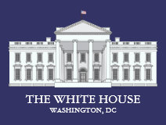
The White House
The message continues to be that tariffs are working.
Hundreds of billions of dollars have come into the Treasury because of the policy.
Real earnings for all private sector workers have outpaced inflation by nearly $1400.
New agreements have been signed helping to enhance and reinforce the national security position of America.

Slide 4
Check on the Economy
Tariffs have not been the disaster that many predicted.
Last Friday’s economic report suggests:
  Inflation dropped to 2.4% in January, down from 2.7%, and close to the Federal Reserve’s 2%.
  Food and energy categories rose just 2.5%, down from 2.6%, smallest increase since March 2021.
  Inflation is cooling and consumer prices are still 25% higher than five years ago.
  Last month’s inflation of 2.4% was the lowest since last May just before the tariffs kicked in.
  Federal Reserve Bank of NY says that nearly 90% of tariff costs are being paid by consumers.
Real wages surge and price relief reaches Americans according to the White House.

Slide 5
White House Options Should Supreme Court Side with the Lower Court?
White House officials, Treasury Secretary, USTR Ambassador, and National Economic Council head has said that President Trump is ready to move forward with other alternatives.
Is February 20th the day? Who knows?
There are five options:
  Section 232: Impose tariffs based on a threat to national security. (DOC)
  Section 201: Impose tariffs based on injury to domestic industry. (ITC)
  Section 301: Discrimination against US businesses or violations under trade agreements. (USTR)
  Section 338: Discrimination against US commerce. (Smoot Hawley Tariff Act)
  International payments (15% tariff rate)
White House believes their “national security” argument has had some affect and that is why we have not seen a decision by the court. Some recent trade agreements have had national security implications for America.

Slide 6
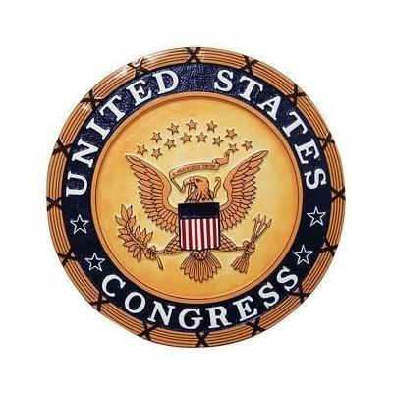
The U.S. Congress
Congress has been and continues to be lobbied by the industry.
Over 150 engagements with both chambers.
Democrats are now working to put members on record opposing Trump tariffs.
First example was last week with six Republicans opposing Trump on Canada tariffs.
The strategy is to do more of these votes over the coming months. Will consumer Congress’ attention.

Slide 7
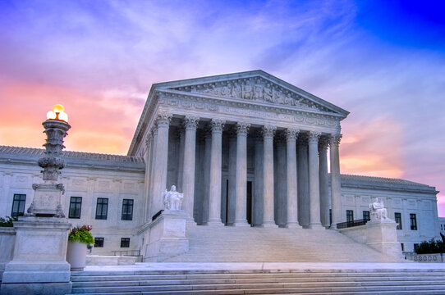
The Supreme Court
The 800-pound gorilla.
Oral arguments were done 11/5/25.
Over 1000 companies have filed lawsuits.
Everyone affected by the tariffs expected a quick decision…nothing.
After the first of the year many said the court would issue a ruling…Nothing.
Certainly, a decision would occur before the Court’s winter recess…No.
Now, what happens on February 20th?

Slide 8

The Supreme Court
The Court has until the end of June to issue its opinions for the term. Can go into July.
Court watchers say that the Louisiana Voting Rights Act case and the tariffs case are both very important.
What may be important to business and politicos may not be important to the Justices.
Let’s examine how Justice Amy Coney Barrett decides on a case…

Slide 9
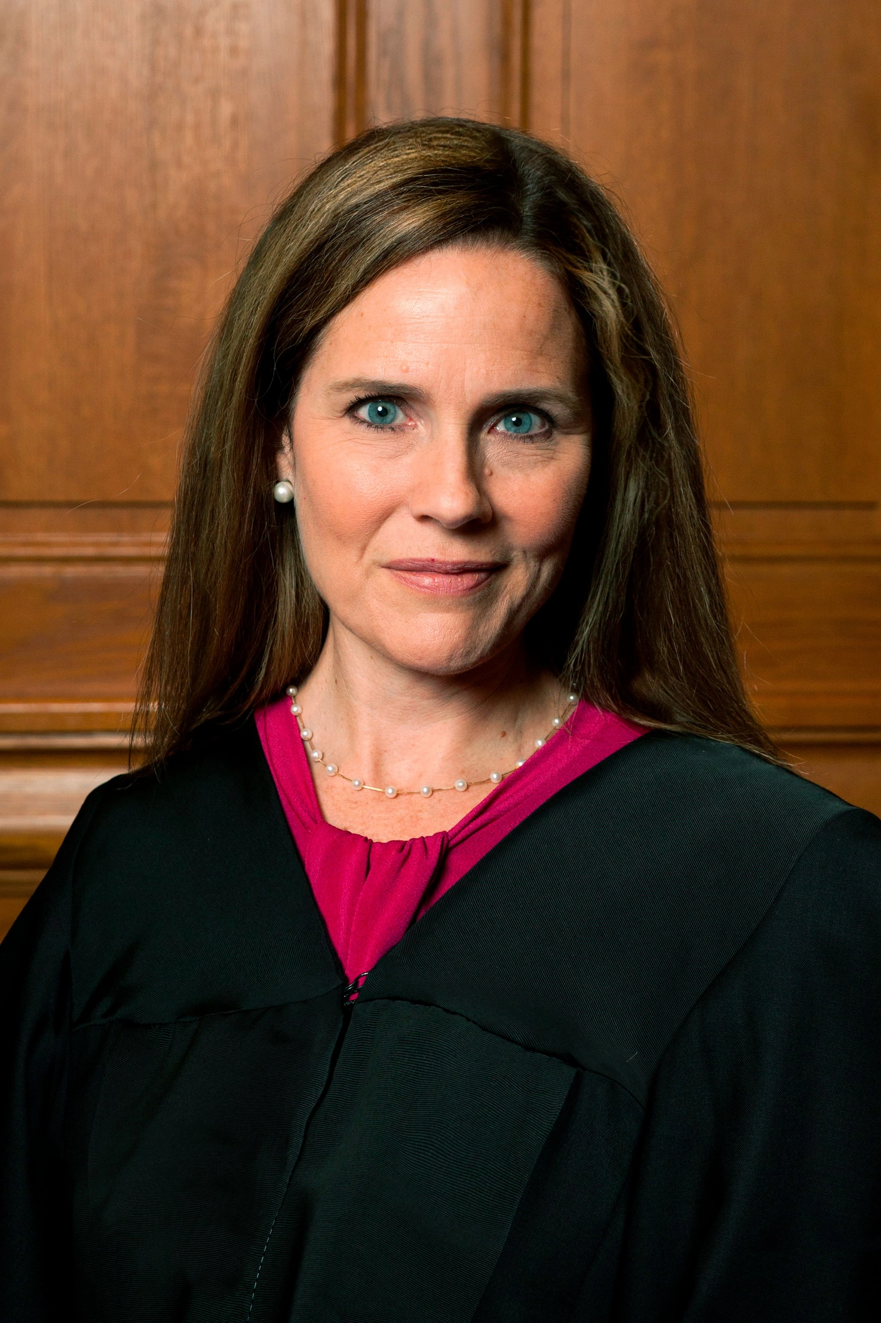
Associate Justice Amy Coney Barrett
Has a very detailed process on how she decides to vote on cases:
  Before the Oral Argument…reads briefs, law clerk memo, relevant cases, statutes, regulations and a bench memo.
  Oral Arguments and conversations with clerks.
  Voting at Conference…the debate. Takes place on Wednesday’s and Friday’s.
  Writing the Opinion…Holding the majority. Can take weeks or months.
  Bench Statements…author reading the summary.
The decision-making process is complex. Sometimes justices come to the same conclusion or sometimes they land in different places.

Slide 10
Conclusion
The American economy continues to astound economists, and the market continues to set new records. Broke 50,000 in early February 2026.
Tariff costs have in fact permeated the economy, but the effect has not met expectations.
The US brought in close to $200 billion last fiscal year, most from tariffs and import fees. The Tax Foundation says that the tariffs amounted to an average tax increase of $1000 per household.
Congress is now beginning to take votes on specific country tariffs.
All eyes are now on the Supreme Court and when they will issue their opinion.

Slide 11

Mark Anderson
Founder & Managing Partner
TAG Consulting Group, LLC
Mark@TAGConsultingGroupLLC.com
202.983.4910 | Cell

