Slide 1
APA Winter Meeting 2026
Steven Andrews, Acting Senior Regulations Officer │ Standards and Rulemaking Division │ February 2026

Slide 2

Highlighting Executive Orders - Shaping Safe Transportation

Slide 3





Key Executive Orders (EO)
Unleashing Prosperity Through Deregulation (EO 14192)
Unleashing American Energy (EO 14154)
Deregulation mandate (10 for 1)
Net negative cost requirements
Focused regulatory analysis of cost-benefit and justification
Swift approval and construction
of energy infrastructure permitting
Expand domestic energy production
Secure national energy independence
Repeal of climate-centric risk assessments
Critical mineral and mining expansion

Slide 4

DOT Regulatory Reform Efforts
In April 2025, DOT’s Office of the Secretary issued an RFI on deregulatory opportunities that could cut costs and improve efficiency while maintaining safety. Comments closed May 5, 2025, with ongoing submissions accepted.
Advance Notice of Proposed Rulemaking (ANPRM) (HM-265B): In June 2025, PHMSA solicited feedback on whether to repeal or amend any Hazardous Materials Regulations (HMR) requirements to improve efficiency and reduce unnecessary burdens. The ANPRM also requested suggestions on well-used special permits that could be suited for regulation. Comments closed August 4, 2025.

Slide 5

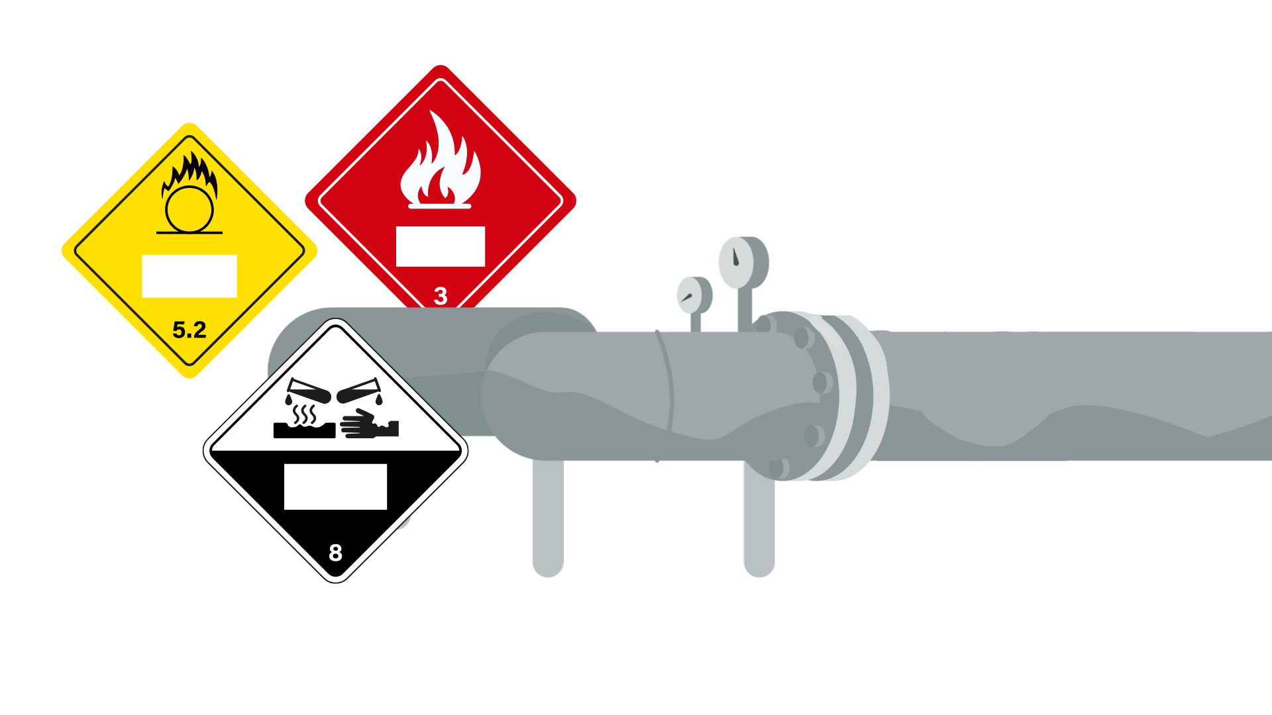
HM-268(A-Q) – Deregulatory NPRMs​
July 1, 2025 – PHMSA published 17 Notice of Proposed Rulemakings (NPRMs) in the Federal Register, eliminating outdated, unnecessary, and overly burdensome regulatory requirements within the HMR.
Comment period closed on September 2, 2025.
Notes:
HM-268A: Reducing Burdens on Domestic Aerosol Shippers Proposes to revise the aerosol definition in § 171.8 to remove the requirement that it contain a liquid, powder, or paste. This would let small quantities of gas be shipped in aerosol containers instead of more costly cylinders or needing a special permit, aligning with international standards—helping U.S. companies compete globally.
HM-268B: Reducing Costs to Domestic Shippers and Carriers of Limited Quantities Proposes allowing a smaller limited quantity marking in § 172.315(a)(2), reducing packaging and labeling costs and helping carriers move more packages per trip.
HM-268C: Reducing Burdens on Domestic Companies Using Battery-Powered Equipment in Trades Proposes updating § 173.6 to increase the amount of lithium batteries allowed under the Materials of Trade (MOTs) exception. This would help companies using battery-powered equipment, like landscapers, to transport needed tools.
HM-268D: Hazardous Materials: Reducing Burdens to Domestic Carriers Proposes allowing emergency response information (ERI) to be displayed electronically, removing the current requirement for printed copies and easing compliance for shippers.
HM-268E: Remove Redundant List of U.S. EPA CERCLA Hazardous Substances Proposes referencing the 40 CFR § 302.4 hazardous substance list instead of duplicating it, eliminating 27 pages of duplicative regulatory text in the 49 CFR.
HM-268F: Reducing Burdens by Allowing Continued Use of DOT Special Permit Packaging Proposes allowing continued use of DOT special permit (SP) packaging for its full lifespan, even if the permit isn’t renewed or the original holder no longer exists.
HM-268G: Improving Efficiencies for Special Permits and Approvals Renewals Proposes removing the rule requiring special permit renewal applications sixty days before expiration. This would reduce paperwork and allow permit use provided the renewal is filed before expiration.
HM-268H: Modernizing Payments to and From America’s Bank Account Proposes requiring electronic payment for registration fees, eliminating outdated provisions allowing certified checks to improve payment efficiency.
HM-268I: Removing Paperwork Burdens on Domestic Motor Carriers Proposes removing the requirement in § 107.620 for motor and vessel carriers to carry paper copies of their registration. Digital verification would be allowed instead, reducing unnecessary paperwork.
HM-268J: Reduce Training Burdens for American Farmers Proposes raising the income threshold for farmers exempt from security training from $500,000 to $825,000 to reflect inflation and ease burdens on small and mid-size farms.
HM-268K: Removing Burdensome Rail Reporting Requirements Proposes removing outdated rail regulations and reporting requirements, such as references to steam-era materials and unnecessary reporting to non-federal groups like the Bureau of Explosives.
HM-268L: Adopt DOT Special Permits 12412 and 11646 into the HMR Proposes adopting special permits allowing IBCs and drums to be unloaded while still on transport vehicles when specific safety control measures are followed, easing burdens for various small businesses.
HM-268M: Adopt DOT-SP 21287 into the HMR Proposes adopting a special permit allowing small refrigerating machines with low-risk flammable gases (A2L) to be transported like non-flammable refrigerant gasses, easing compliance burdens.
HM-268N: Adopt DOT-SP 21379 into the HMR Proposes adopting a special permit allowing large refrigerating systems with A2L gases to be transported under the same rules as systems using non-flammable refrigerant gases, reducing compliance burdens.
HM-268O: Adopt DOT-SP 14175 into the HMR Proposes extending the requalification interval for certain gas cylinders from 5 to 10 years, reducing testing costs for companies using these cylinders.
HM-268P: Adopt DOT-SP 21478 into the HMR Proposes allowing empty IBCs with only residue to be transported like non-bulk packages, reducing costs for the IBC reconditioning industry.
HM-268Q: Allow Fireworks Certification Agencies (FCAs) to Approve Professional Fireworks Proposes allowing FCAs to approve both consumer and professional fireworks, speeding up approvals and easing the workload on federal staff.

Slide 6


Pending Rulemaking Actions
Advance Notices of Proposed Rulemaking
HM-224J – Improving safety of transporting damaged, defective, or recalled lithium cells or batteries
HM-266 – Modernizing regs to facilitate transportation of hazmat using highly automated transportation systems – Published December 4, 2025; Comment period closes March 4, 2026
This Photo by Unknown Author is licensed under CC BY-SA-NC

Slide 7
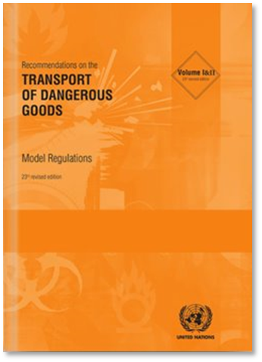


Notices of Proposed Rulemaking
Pending Rulemaking Actions
HM-219E – Modernizing regulatory requirements and responding to stakeholder petitions​
HM-215R – Harmonization with international standards
HM-215S – Harmonization with international standards
HM-233G – Continued conversion of special permits
HM-265A – Streamlining and modernizing regulations to improve safety and efficiency
HM-265B – Mandatory regulatory review to unleash American energy and improve government efficiency

Slide 8
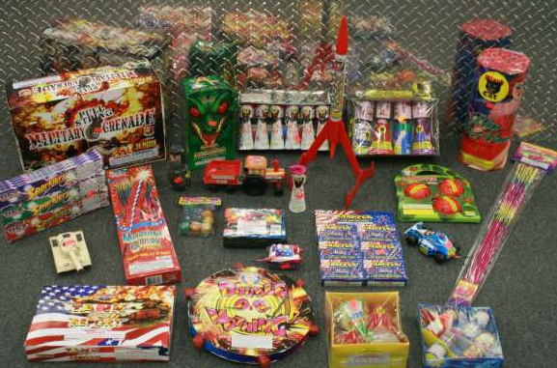
Pending Rulemaking Actions
Final Rulemakings
HM-257A – Streamlining requirements for the approval of certain energetic materials
HM-208J – Adjusting registration / fees (Withdrawal) – Published November 20, 2025

Slide 9
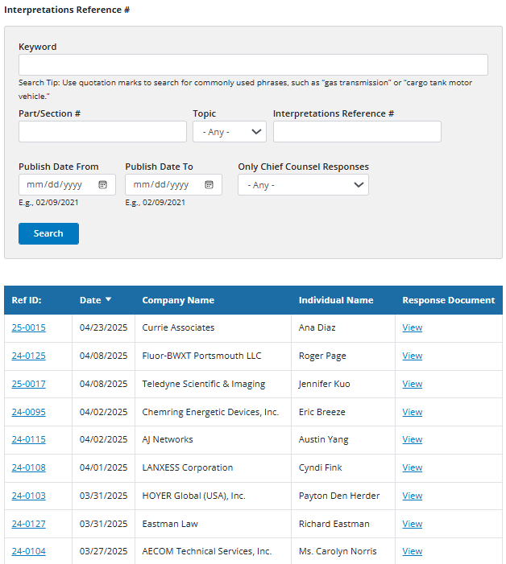
Revised Interpretation Process
Public Posting of Requests: Once PHMSA receives and performs an initial review of a Letter of Interpretation (LOI) request, it is posted to a new "Pending Interpretations" webpage.
30-Day Open Comment Window: Stakeholders have a 30-day window from the date of posting to submit feedback, data, or best-practice information regarding the specific regulation in question. Comments are submitted directly through the PHMSA website.
Final Review and Issuance: After the 30-day period expires, PHMSA reviews the public input to ensure the final interpretation is technically accurate and considers real-world compliance implications.

Slide 10
APA Winter Meeting 2026 UN Issues Relevant to APA
Steve Webb, Assistant Coordinator│ International Program│ February 2026

Slide 11

Agenda
UN global framework
Energetics working group
Facilitation issues
Other international work

Slide 12
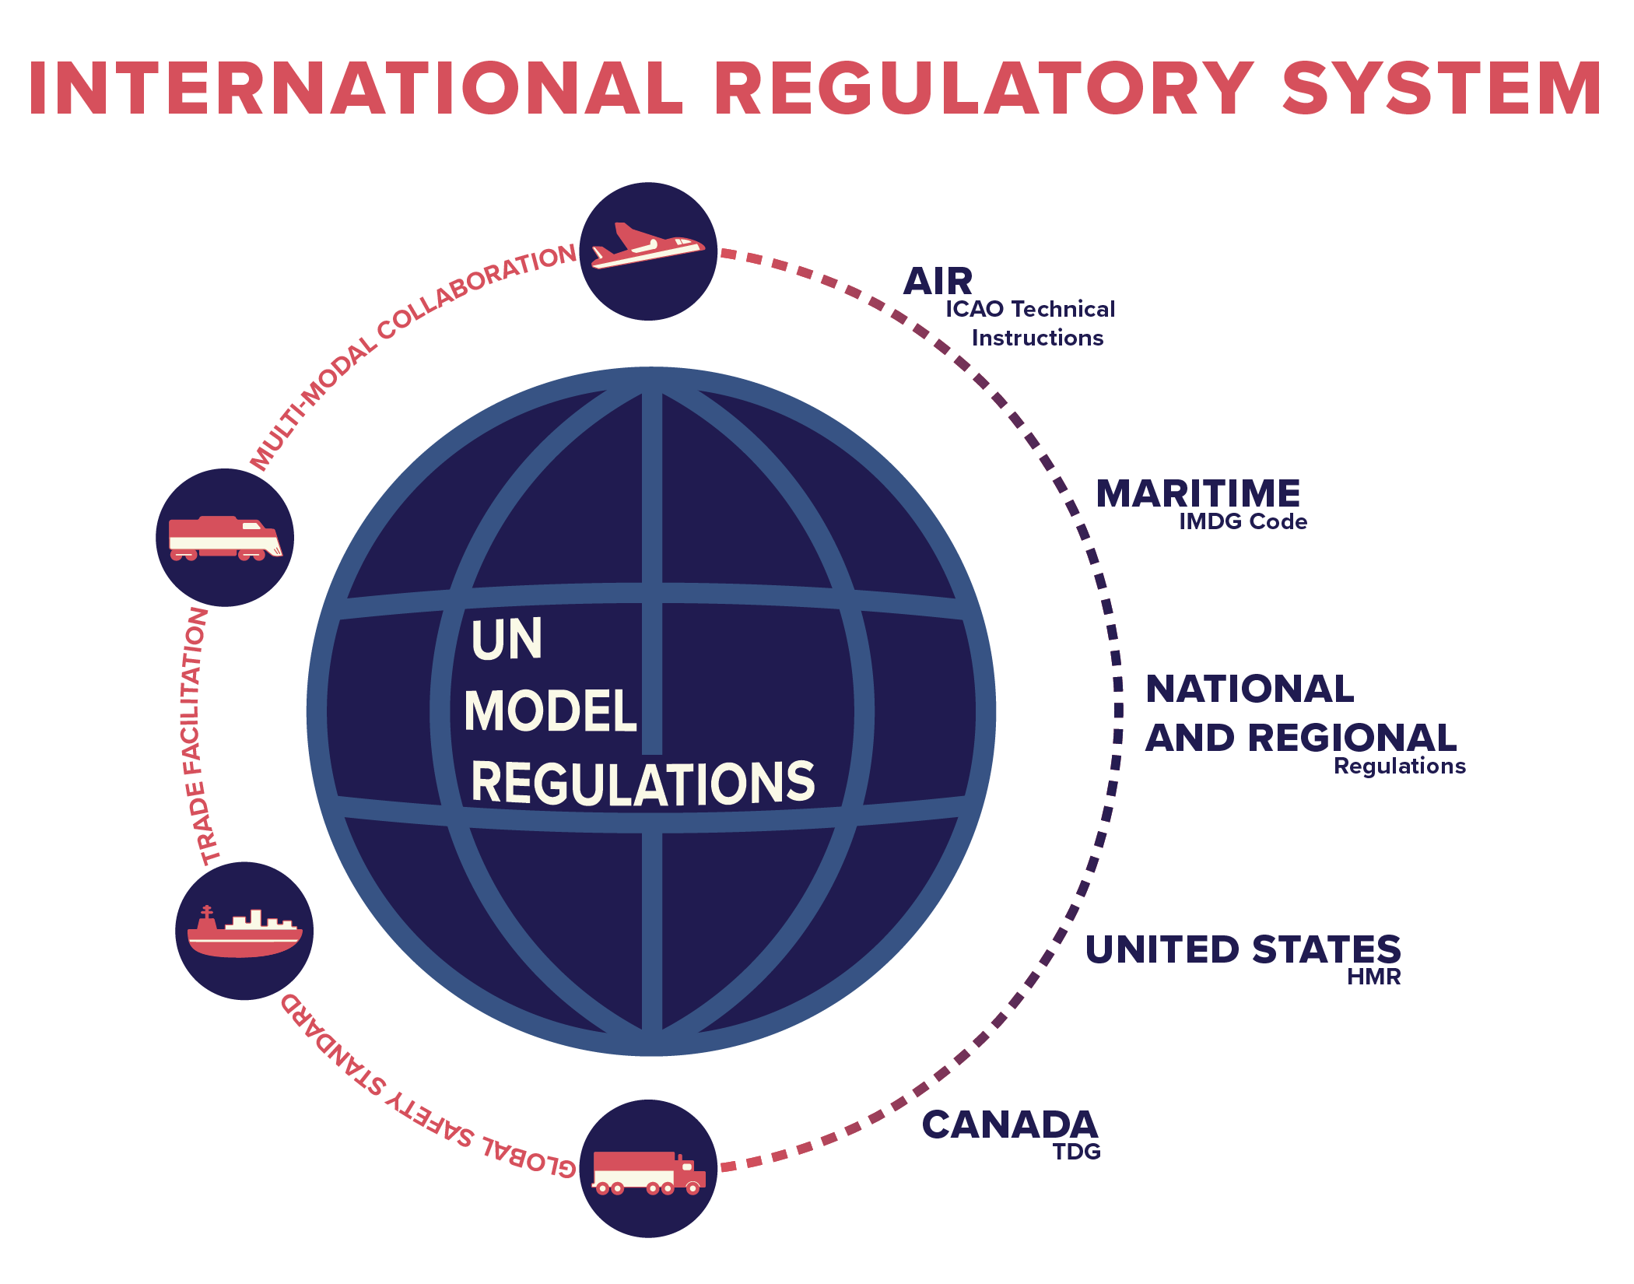
UN Global Safety Framework

Slide 13
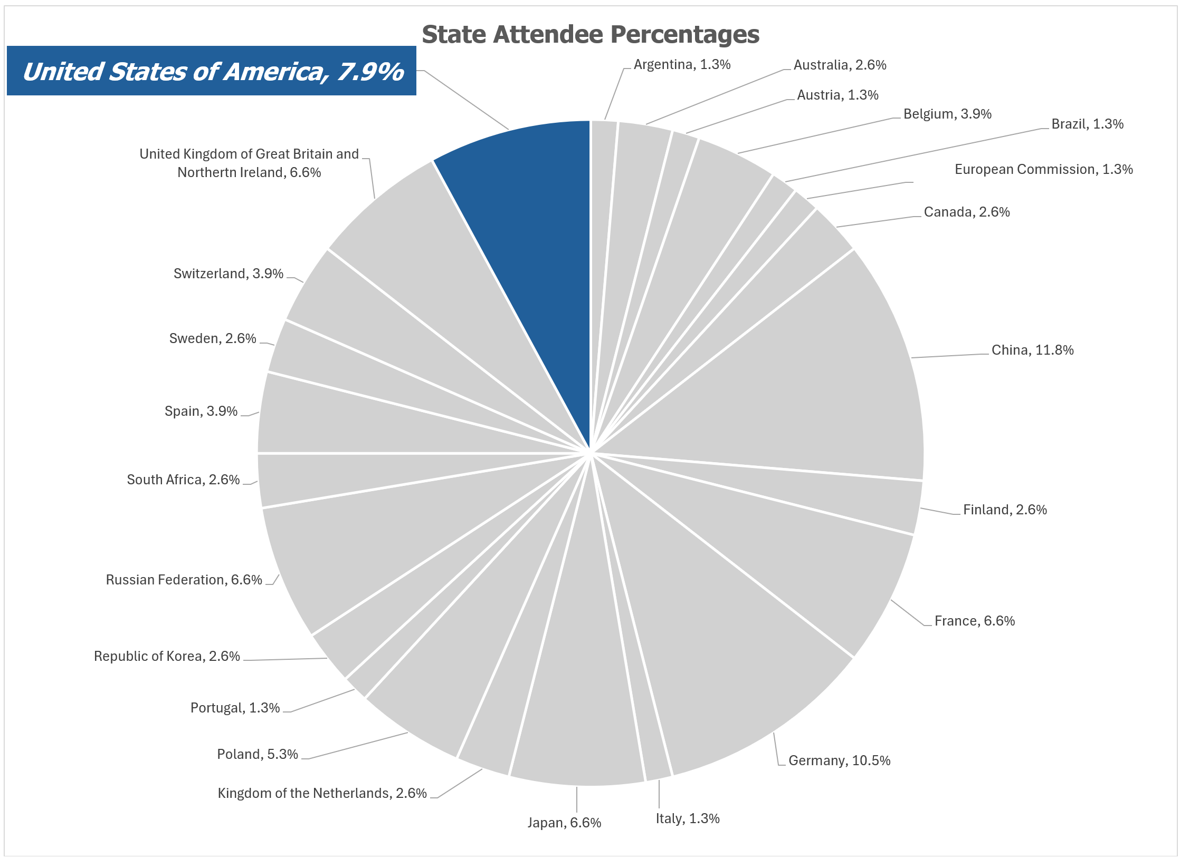
Individual Participation
67th Session
132* - Individuals Present
24 - Member States Present
67th Session
Total Member States | 24
Total of Individuals | 76
% of US Individuals | 7.9%
66th Session
Total Member States | 22
Total of Individuals | 81
% of US Individuals | 11.1%
*11% drop in attendance

Slide 14
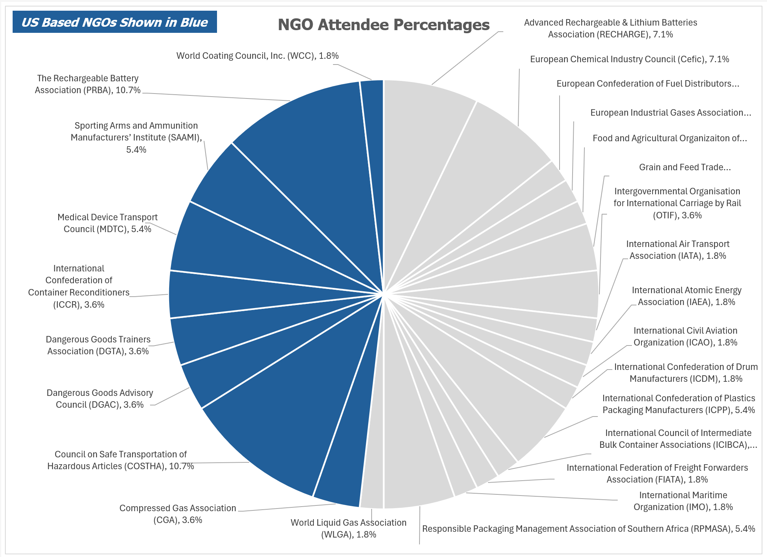
Individual Participation
67th Session
24- NGOs Present
9 – US NGOs Present
48% - US NGO Individuals
67th Session
Total NGOs | 26
US NGOs | 9
% of US NGOs | 34.6%
66th Session
Total NGOs | 30
US NGOs | 10
% of US NGOs | 33.3%

Slide 15

Energetics Working Group (EWG)
Other International Work
Other International Work
Sub-Committee meets four times during a biennium (July and December each year)
EWG meets twice during the biennium (July sessions)
Experts in explosive and energetics from Competent Authorities and recognized non-governmental organizations
Issues related to explosives including classification, testing, packaging, and hazard communication
Sub-Committee decisions on explosives related proposals rely greatly on the expertise and opinions of the EWG

Slide 16
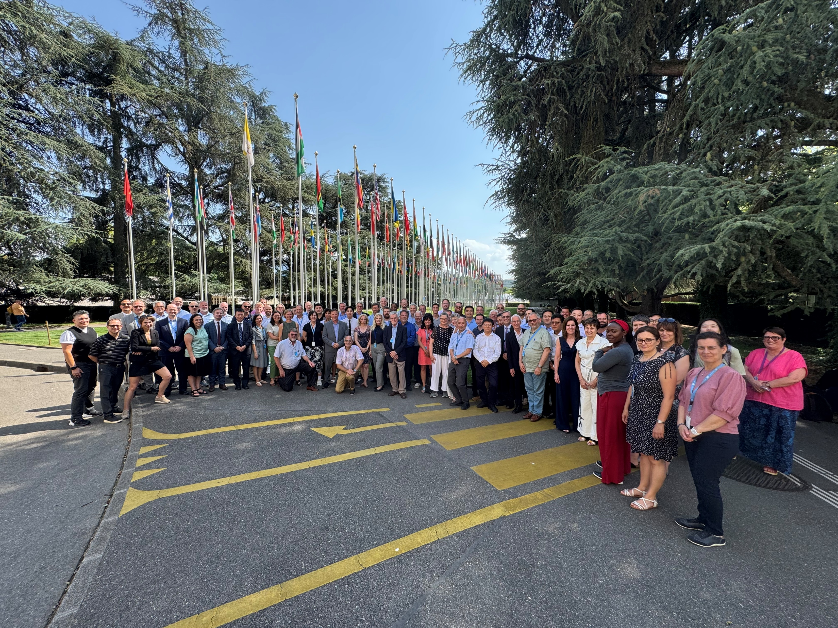
Energetics Working Group (EWG)
Other International Work
Other International Work
UN Sub-Committee granted consultative status to APA in July 2024
What does that mean for APA?
What expectations does the UN Sub-Committee have?
What objectives does the APA have and how does that support the work of the Sub-Committee?
What are the procedural opportunities and limitations?

Slide 17




Other International Work
Other International Work
Other International Work
International Civil Aviation Organization, Dangerous Goods Panel
PHMSA is lead U.S. agency
International Maritime Organization, Carriage of Cargoes and Containers Sub-Committee and Editorial and Technical Group
PHMSA is Chair of E&T Committee
Joint Meeting of the UN ADR (Road)/RID (Rail)/ADN (Inland Waterways) Safety Committee
International Atomic Energy Agency's Transportation Safety Committee
PHMSA is lead U.S. agency

Slide 18
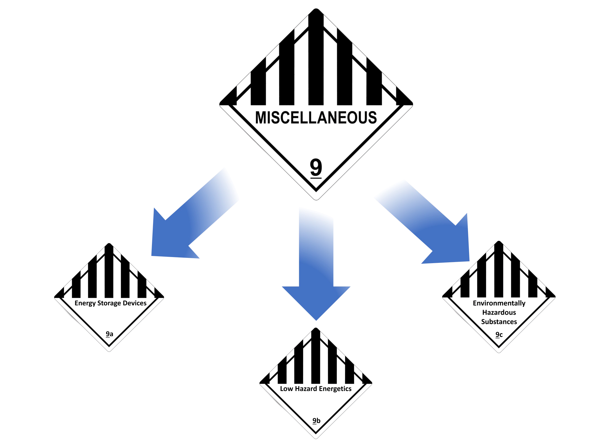
Class 9
Creating Class 9 subdivisions for increased hazard awareness and transport efficiency (USA)
Broad support to create clearer divisions. Specific interest in:
Energy storage devices
Low hazard energetics
Environmentally hazardous substances
Proposed Next steps: Engage with stakeholders to develop framework for a future U.S. proposal in line with vision – targeting this biennium for a solution that can be considered to by the UN Sub-Committee.

Slide 19
Upcoming Meetings
ICAO
DGP-WG26 Fall 2026
IMO
CCC12 September of 2026
Joint Meeting
Joint Meeting of the RID Committee of Experts and the Working Party on the Transport of Dangerous Goods March 24-27, 2026
UN Sub-Committee of Experts on the Transport of Dangerous Goods
68th session June/July 2026
Information about public meetings and upcoming events:
https://www.phmsa.dot.gov/international-program/international-program-overview

Slide 20



Thank you

