Slide 1


NASFM & APA: Guidance Document on Fire Inspection and Consumer Fireworks
Collaborating for the Future
Presented by Philip Oakes
NASFM COO

Slide 2
Welcome
Philip Oakes
Chief Operating Officer
National Association of State Fire Marshals
Retired Fire Chief
Previous Head of State Fire Training – State of Wyoming
Currently serve of the Board of Directors for the National Board on Fire Service Professional Qualifications

Slide 3
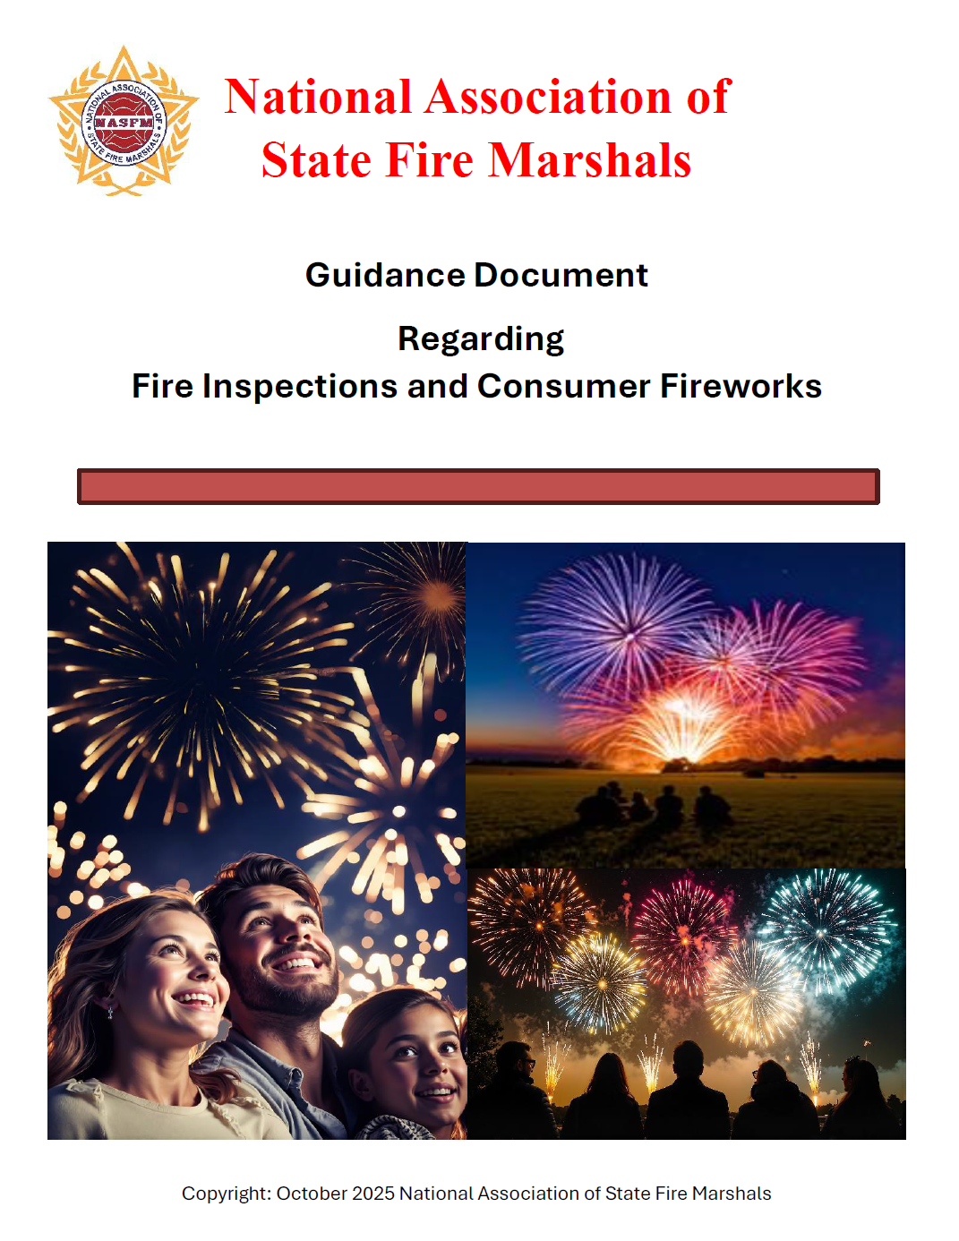
Here it is:
Guidance Document regarding Fire Inspections and consumer Fireworks https://www.firemarshals.org
Notes:
This is what my presentation is about

Slide 4

Standard Issues
Confusion on both sides
Dwindling knowledge base
Lack of consistency
Time for follow up
WHY?
Notes:
Fire Marshals and fireworks typically don’t go together – but the time has come

Slide 5

History
Due to the standard’s section withdrawal
Due to a lack of knowledge
With the support of Industry
NASFM/FM Global (Now FM) – conducted a study and live fire exercise
Intent was to provide scientific data to support development of new or updated standard
Real-world impact​
Notes:
1999 – Change of scope to standard – Expanding to include retail sale of commercial fireworks (printed 2003)
2007 – Standards organization did a study (lit review) to develop the standard
2008 – Fire works industry did a series of 12 tests to help develop the standards
2009-2010 – Discussions had on withdrawal pending need for scientific evidence
2011 – NASFM and FM – with Fire Protection Research Foundation (UL) test plan in place and approved by all parties – testing conducted and report submitted to standards body
2014 – Standard chapters 6 and 7 withdrawn – Stuck with 2013 edition – 14 states still use today

Slide 6

Where do we go from here?
Notes:
Based on feedback received from members and fire marshals around the country NASFM partnered with APA
Intent was to see what was out there, grab best practices, old and current standards and guides and put together something.
Thus this document is born

Slide 7

What's in It?
History
Notes on the previous standard
  List of states and how it is applied
Sample General Safety Plan
Inspector/Inspections Sections
OSHA Guidance
Sample forms, references and terminology
Notes:
Inspector Sections are broken down
Temporary
Mercantile
Permanent
Storage
So the inspector does not have to hunt

Slide 8

How?
No good project built in a vacuum
NASFM and APA Established a work group
  Technical expertise on both sides
Lead writer/assembler
  Words have meaning (Should, shall, may , must)
8 Iterations of the document
Notes:
Thank everyone, don’t mention specific names as you will likely miss someone but mention organizations

Slide 9
What?
Useable by anyone
Accessible – currently free online
Acceptable to anyone
  Not trying to rewrite laws or standards but provide guidance and education
Living document
Notes:
Help those that need it the most

Slide 10
Albert Einstein
“Strive not to be a success, but rather to be of value.”
Notes:
Obviously we hope for both, but we do believe this will be of value by all parties moving forward.
Document is already being used by the State of Missouri,

Slide 11


Questions

Slide 12

Thank you
Philip Oakes
Chief Operating Officer
National Association of State Fire Marshals
Phil@browning.red or
admin@firemarshals.org

