Slide 1


Matt Chillinsky
Notes:
took a leave of absence from Disney in July 2024 and ultimately retired in January 2025 after 17+ years with the company.
I made the transition away from Disney—something I had considered for a long time but found difficult because I felt there was still so much I wanted to contribute.
When I left, I honestly thought I was done with the entertainment industry entirely.
But something unexpected happened.
After working through the personal and professional transitions of the past year, I discovered that my passion for creating never left me. In fact, it intensified. Starting in October 2025, creative ideas that I had been suppressing—while focused on doing my job for Disney- began pouring out of me.
I’m here today to share one of those creations with the APA. It is probably the most exciting, glamorous dare I say sexiest subject in our industry… it is of course

Slide 2
Fireworks Waste Treatment
Notes:
Waste treatment!
Fireworks waste treatment to be specific..
Super FUN!!!!! Pain in the Butt
Anecdotal experience at Disney, larger scale than professional operators maybe even many municipalities

Slide 3
The Challenge
Utilize existing technologies to solve the primary pain points associated with the disposal of fireworks, pyrotechnics and the waste created by the manufacturer and use of these products.
Notes:
Priority, is to solve the pain points,
Under RCRA—the Resource Conservation and Recovery Act—fireworks waste is classified as **hazardous waste** when it's damaged, failed, or discarded.
>
> That means we can't just throw it in the trash. We can't bury it. We can't burn it in our backyard.
>
> We are required by regulations to dispose of it at **authorized facilities** using **approved methods.**

Slide 4




Problems to Solve
Hazardous
Environment
Life
Property
Inconvenient
Complex processing/paperwork
Logistics
handling
Expensive
Training
Storage
Cost of Service
Regulation Heavy
EPA
DOT
ATF

Slide 6
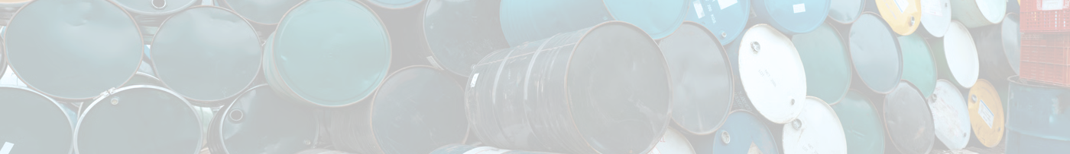
The Current Options
There are three main options:
Open Burning/Open Detonation
Indoor incineration
Cement Stabilization
Notes:
Some municipalities consider “shipping out of state” a method of disposal……
We will show a 4th later, a failed attempt from the early 2000’s

Slide 7
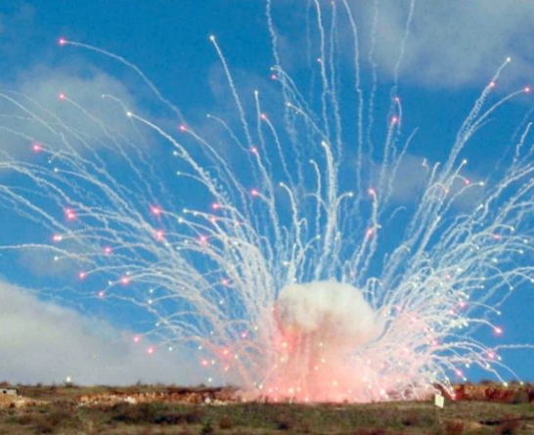
Open Burning (OB/OD)
01
For decades, this has been the primary method for disposing of fireworks waste. You take the fireworks out to an open field, you burn them or detonate them.
In March 2024, the EPA proposed new regulations that would reduce open burning and open detonation and require facilities to evaluate and implement alternative technologies.
Environmental Impacts, multiple fatal accidents,The EPA memorandum explicitly states that OB/OD "poses risks to human health and the environment"
QUICK TIP
Try right clicking on a photo and using "Replace Image" to show your own photo.
Notes:
**Same for Method 1 and 2 Description:** Fireworks waste is packaged according to Department of Transportation (DOT) hazardous materials regulations and transported to out-of-state facilities licensed to handle explosive materials. The receiving facility typically uses open burning, open detonation, or indoor incineration to destroy the materials.
Fireworks waste is burned or detonated in open-air settings, typically on government-owned land or specialized facilities. This method has been used for decades for military ordnance disposal and was historically common for fireworks waste.
various state and local confiscation programs, display operators
**Cost structure:
- **Typical range:** $8-12 per pound depending on volume, distance, and receiving facility requirements AND RISING!!!!
ADDITIONAL COSTS: DOT compliance, packaging materials, insurance, storage pending transportation
**Example:** California's 2025 confiscations of 600,000 pounds would cost **$6 million** for out-of-state disposal at $10/lb. The current stockpile represents **$2 million in disposal costs with zero dollars in available funding**.[1]
**Environmental impact: releases perchlorate, heavy metals, and other contaminants into air, soil, and groundwater. California's Department of Resources Recycling and Recovery explicitly states that burning fireworks is "not environmentally friendly" because it creates smoke containing chemicals that affect water quality.[1]
**Safety concerns:** Transportation of hazardous materials presents inherent risks, including vehicle accidents, cargo fires, and improper handling. DOT regulations mitigate but do not eliminate these risks.
**Scalability:** Limited by availability of licensed receiving facilities (primarily in states with less restrictive environmental regulations) and transportation logistics. As waste volumes increase, transportation costs and risks scale proportionally.
**Description:** Fireworks waste is burned or detonated in open-air settings, typically on government-owned land or specialized facilities. This method has been used for decades for military ordnance disposal and was historically common for fireworks waste.
**Primary users:** Military installations, some government agencies, legacy disposal operations
**Cost structure:**
- **Direct costs:** $3-6 per pound for site preparation, labor, and cleanup
- **Regulatory costs:** Environmental permits, air quality monitoring, groundwater testing
- **Liability costs:** Insurance, potential cleanup costs for contamination
**Environmental impact:** The U.S. Environmental Protection Agency has documented extensive environmental concerns with OB/OD methods. A 2017 EPA memorandum on waste fireworks specifically notes that open burning releases perchlorate (a thyroid disruptor), heavy metals (lead, copper, barium, strontium), and particulate matter into the environment.[2] Groundwater contamination from OB/OD sites has been documented at multiple military installations, with cleanup costs exceeding millions of dollars.
**Safety concerns:** OB/OD has resulted in multiple fatal accidents:
- **Fort Rosecrans, California (1980):** 3 deaths, 1 injury among EOD employees during disposal operations[2]
- **Lansing, Kansas (2012):** 1 death during open burning of failed display fireworks[2]
The EPA memorandum explicitly states that OB/OD "poses risks to human health and the environment" and recommends alternative treatment methods where feasible.[2]
**Scalability:** Increasingly limited by environmental regulations, public opposition, and liability concerns. Many jurisdictions have banned or severely restricted OB/OD operations. The method is not viable for urban or suburban locations where most fireworks waste is generated.

Slide 8
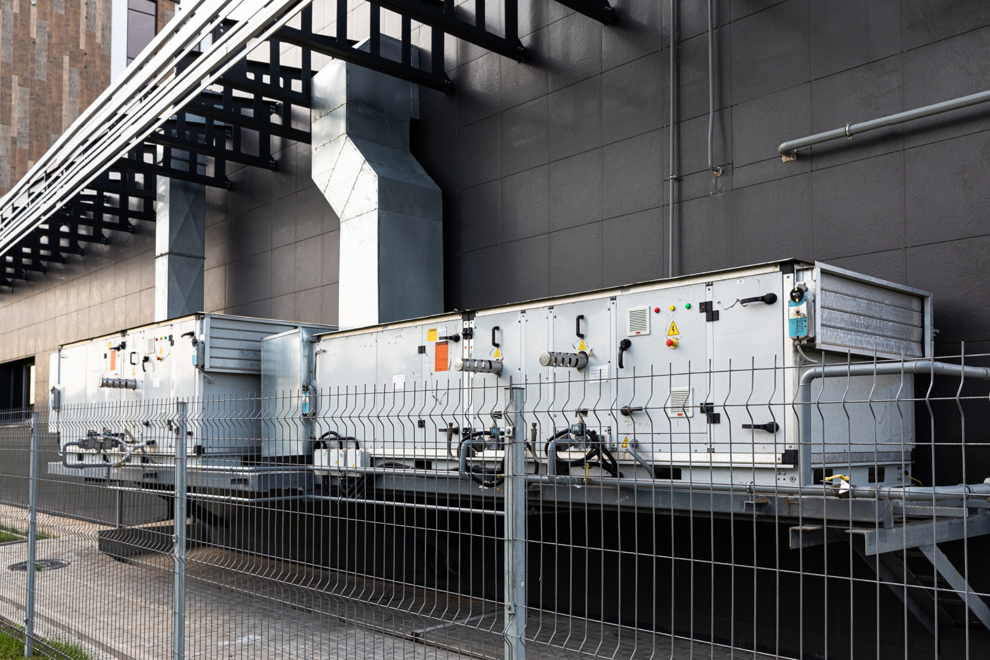
Indoor Incineration
02
Indoor incineration uses enclosed chambers with emission controls. The waste is burned inside a sealed unit, and the emissions are captured and treated before being released.
Disposal facility in Utah experienced property damage during the incineration of fireworks waste.
Currently only approved for 1.4G
Increased processing, handling, infrastructure
Notes:
Same for Method 1 and 2 Description:** Fireworks waste is packaged according to Department of Transportation (DOT) hazardous materials regulations and transported to out-of-state facilities licensed to handle explosive materials. The receiving facility typically uses open burning, open detonation, or indoor incineration to destroy the materials.
It sounds great in theory. But in practice, **it's hazardous, limited- and can not accept 1.3G. Desensitized.- 2024 Utah facility explosion -
Disney's experience: No disposal options, filed EPA extensions
- Small companies don't have Disney's resources
- Limited capacity, long wait times, high costs
>

Slide 9
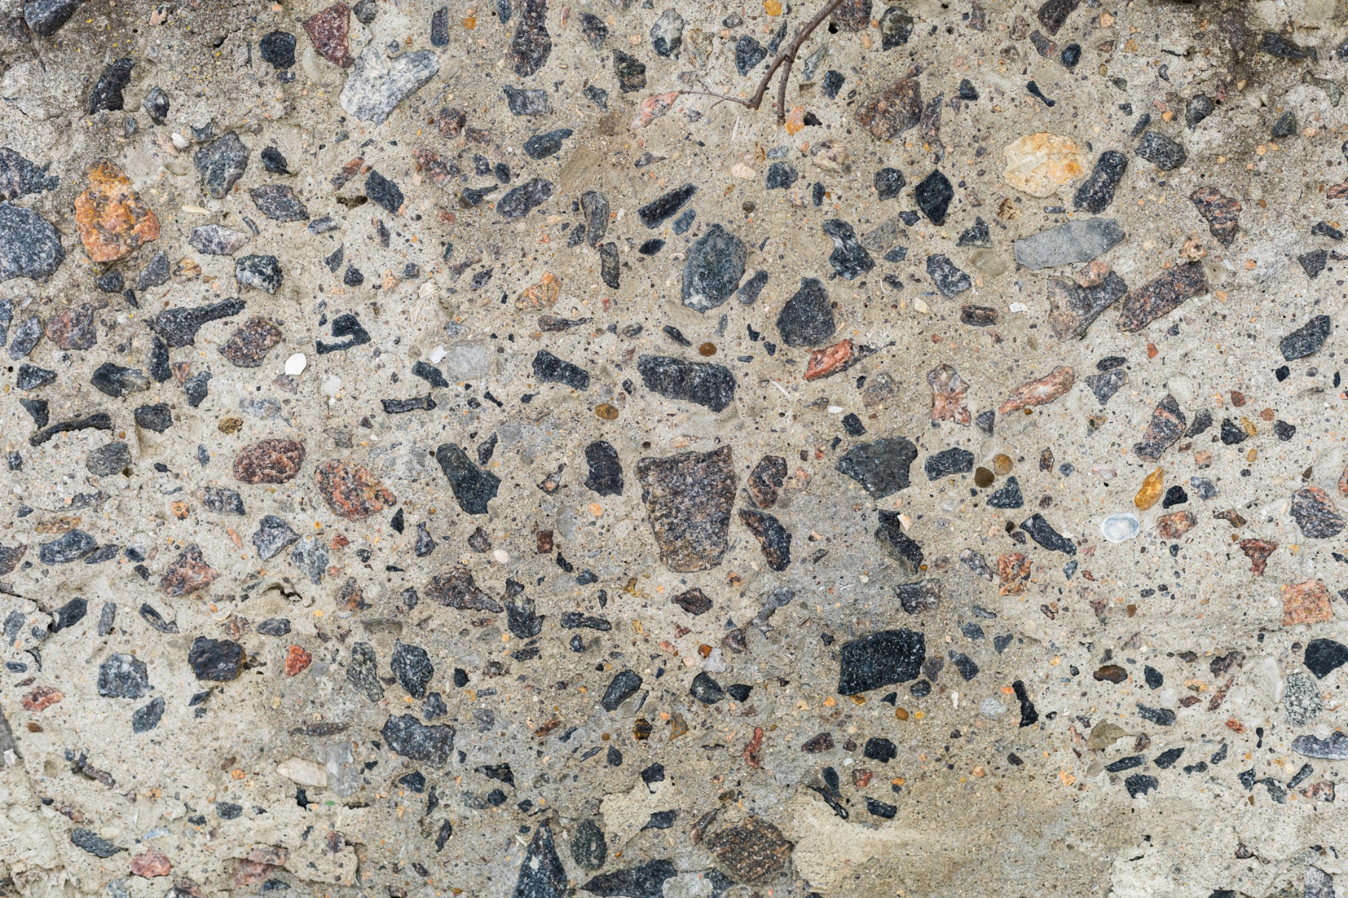
Cement Stabilization
03
Fireworks waste is mixed with cement, binding agents, and water to create a solid matrix that immobilizes contaminants. The resulting material can be used in construction applications (roads, walls, foundations) or disposed of in non-hazardous waste landfills.
Cement stabilization/solidification does not neutralize or destroy contaminants; it immobilizes them within a solid matrix (in theory)
Notes:
**Environmental impact:** Cement stabilization/solidification does not neutralize or destroy contaminants; it immobilizes them within a solid matrix. Perchlorate, heavy metals, and other hazardous materials remain present but are prevented from leaching into groundwater (in theory). The U.S. Environmental Protection Agency considers stabilization/solidification an acceptable treatment method for many hazardous wastes, but long-term effectiveness depends on matrix integrity.[4]
Advantages over OB/OD:**
- No air emissions during treatment
- Reduced groundwater contamination risk (if matrix remains intact)
- Beneficial reuse of treated material in construction
**Limitations:**
- Contaminants remain present (not neutralized or destroyed)
- Matrix degradation over time could release contaminants
- Construction applications may be limited by regulatory restrictions on hazardous waste-derived materials
- No value recovery from fireworks components (metals, chemicals)
**Safety concerns:** Treatment process itself is relatively safe compared to burning or detonation. Primary risks involve handling untreated fireworks waste prior to stabilization.
**Scalability:** Moderate. Cement stabilization facilities exist in many regions, but capacity may be limited for large-volume fireworks waste. Transportation to facilities remains a barrier for distributed waste sources.

Slide 10
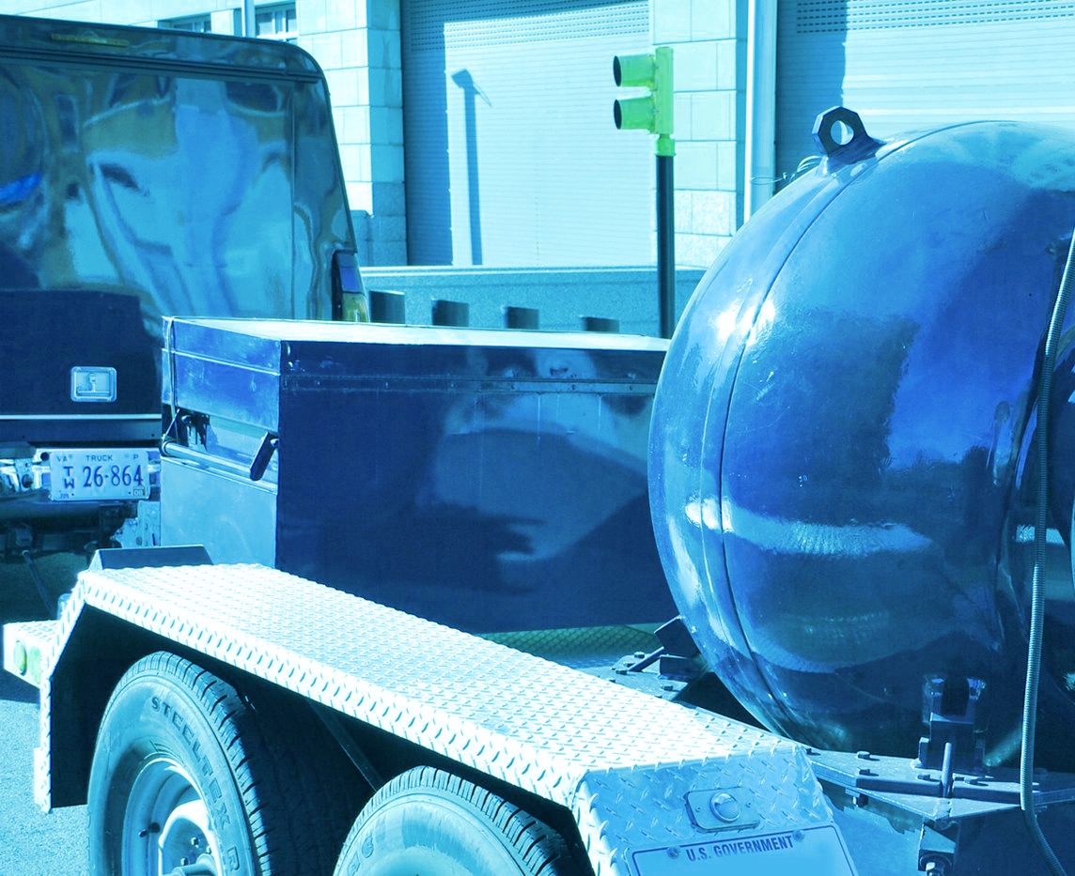
Mobile Blast Chamber
04
Specialized mobile units equipped with blast chambers and grinding equipment. Fireworks are ground into smaller particles and then "torched off" in a contained blast chamber. Ash and debris are collected and sent to permitted hazardous waste facilities.
The mobile blast chamber concept was developed and patented in the early-2000s.
Notes:
**Development history:** The mobile blast chamber concept was developed and patented in the early-2000s. DTSC announced plans to deploy four mobile treatment units in 2008 to address California's fireworks disposal needs.[3] However, widespread deployment never materialized, and the patent was subsequently abandoned. Current use appears limited to specialized applications.
**Environmental impact:** Similar to OB/OD, the "torching" process releases contaminants into the air, albeit in a more controlled setting. Ash and debris must still be disposed of as hazardous waste, transferring rather than eliminating the environmental burden.
**Safety concerns:** Blast chamber containment reduces but does not eliminate explosion risks. The grinding process itself presents hazards when processing energetic materials.
**Scalability:** Limited by high capital costs, operational complexity, and Class 1.4 limitation. Not suitable for high-volume operations or higher-hazard fireworks.

Slide 11
Summary
Current methods are the cause of many of the problems we wish to address. There is no method or combination of these that addresses all of the issues.

Slide 13

The Solution
A fundamentally different approach to fireworks disposal, based on neutralization and recapture rather than destruction or encapsulation. Designed for containerized, mobile deployment to enable on-site processing and eliminate hazardous material transportation.

Slide 14
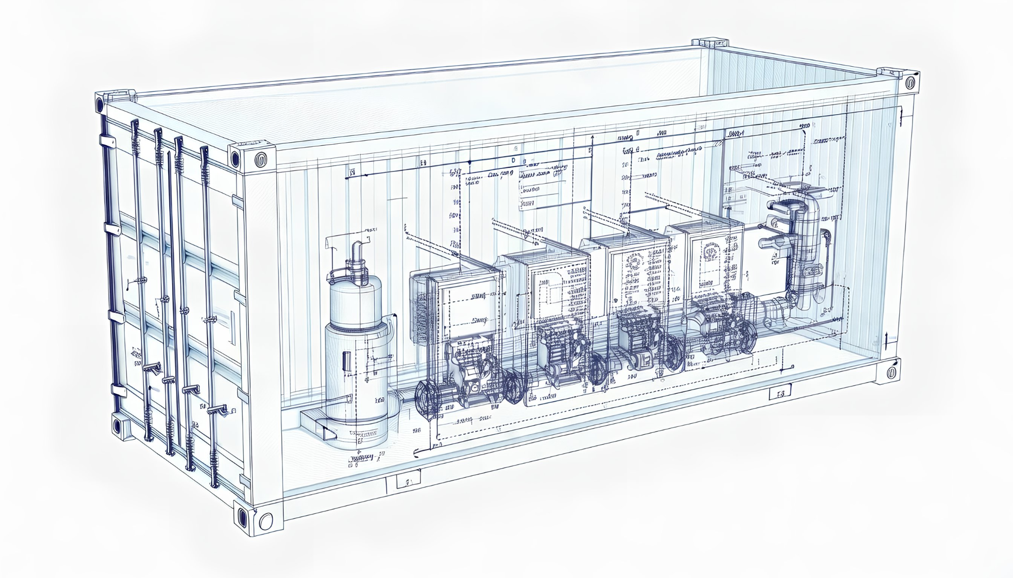
The AFN-100
Symbiosis Industries’ patent pending AFN-100 neutralizes and transforms hazardous materials rather than destroying or encapsulating them. No hazardous waste is generated—all outputs are either marketable byproducts, recovered energy, or environmentally safe water
Notes:
**Key principle:** AFN-100 neutralizes and transforms hazardous materials rather than destroying or encapsulating them. No hazardous waste is generated—all outputs are either marketable byproducts, recovered energy, or environmentally safe water.
### Containerized / Mobile Deployment Model
Unlike traditional disposal facilities that require permanent infrastructure and hazardous material transportation, AFN-100 is designed for scalable, mobile deployment:
**First articles:** 20-foot or 40-foot shipping container units containing all processing equipment, chemical storage, and control systems. Containers are self-contained and require only external power and water connections.
**Power requirements:** 3-phase 240V electrical service (scalable based on container size and throughput requirements). A 40-foot container unit processing 500 lbs/day requires approximately 50 kW continuous power.

Slide 15




Problems the AFN-100 Solves
Safe/Environmentally Friendly
No Emissions
All byproducts are environmentally safe AND Saleable
Easy to Use
No preprocessing required
Load full boxes of material
Minimal training required
Affordable
More affordable than current methods
Reduces operational costs
Streamlined
Automated, on-site processing
Reduced compliance demands
Reduced risk exposure

Slide 16

Safer
01
AFN-100 process is dramatically safer than all current options.
Safer for:
Environment
Life
Property
QUICK TIP
Try right clicking on a photo and using "Replace Image" to show your own photo.
Notes:
Include the elimination of transporting hazardous waste.- safer roads, no special endorsement to transport end products.
Reduction in handling
This is not destructive, it is recovery

Slide 17

Less Expensive
02
AFN-100 material costs (chemicals, consumables, utilities) are estimated at approximately $2.50 per pound of waste processed. This figure represents direct processing costs only
Chemical reagents
Consumables
Utilities
Waste treatment (minimal—only non-hazardous solid waste from packaging materials)
Notes:
**Not included in $2.50/lb figure:**
- Capital equipment amortization (container unit, processing equipment)
- Labor costs (operators, technicians, supervisors)
- Transportation costs (moving container units between sites—eliminated for permanent installations)
- Facility overhead (rent, insurance, administration)
- Profit margins or business model costs

Slide 18
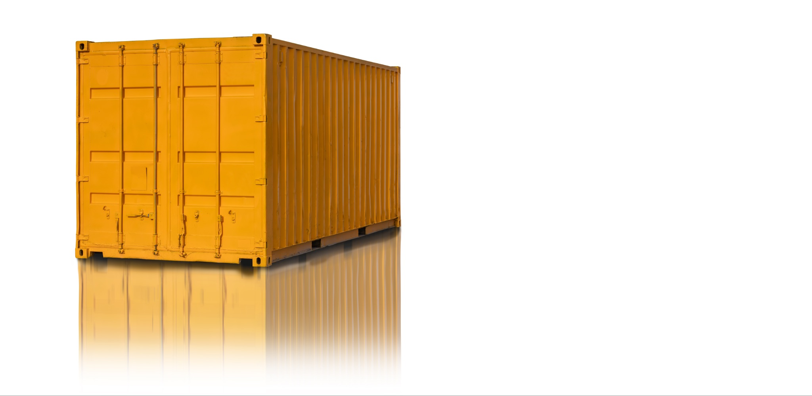
Convenient
03
Unlike traditional disposal facilities that require permanent infrastructure and hazardous material transportation, AFN-100 is designed for scalable, mobile deployment
On-site processing eliminates one of the largest factors in current disposal methods—transportation of hazardous materials. AFN-100 brings the processing capability to the waste location, reducing total system costs even before considering byproduct value recovery.

Slide 19

Reduces Red Tape
04
Eliminates DOT hazardous material transportation requirements
Fireworks waste never leaves the site where it's generated or stored
No DOT placarding, packaging, or shipping paper requirements
No transportation insurance or liability concerns
No risk of transportation accidents or cargo fires

Slide 20
What’s Next?
Notes:
Update on any APA status….
NDA

Slide 21
Thank you.
Tomorrow 2/19/26 Florentine IV

