Slide 1
Office for Bombing Prevention
Counter-IED Strategy, Integration, and Communication Branch
Operation Flashpoint Briefing to American Pyrotechnics Association
Wednesday, February 16, 2022
Notes:
The Bomb-making Materials Awareness Program plays a vital role in preventing criminal and terrorist attacks involving explosive threats.

Slide 2
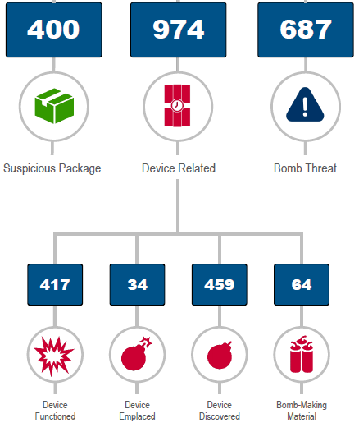
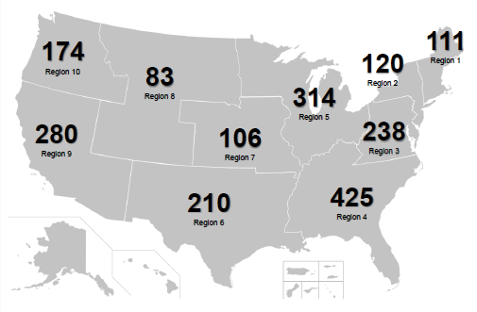
National IED Threat: 2020 Data
TOTAL: 2,061 Incidents
BMAP can be an effective way to counter terrorist plots
Notes:
Statistics come from the 2020 annual Tripwire report
In 2020 - Pyrotechnics, fireworks, mixtures, black powder (and substitutes) were the highest reported material types in IED associated bombings.
Map:
1. Region IV had the highest number of incidents 2. Region V had the second highest number of incidents
3. All Device related incidents increased by 23.9% in 2020 compared to 2019. 4. in 2020 their were 9 people killed in bombing incidents
5. In 2020 their were 152 people injured in incidents
6. In 2020 their were 526 people arrested in relation to bombing incidents.
7. COVID-19 Had a significant impact on the percentages of numbers fluctuating through 2020.

Slide 3
BMAP Program Overview
Description
The Bomb-Making Materials Awareness Program (BMAP), a counter-terrorism risk management bombing prevention program. BMAP focuses on restricting access by malicious actors to explosive precursor chemicals, explosive powders, exploding target materials, associated components, and delivery methods. The program is most effective during the terrorist attack cycle’s planning phase. The two focus areas of BMAP are the acquisition of materials and bomb-building stages.
Objectives
Restrict access by malicious actors to BMM and explosive precursor chemicals (EPC) used to manufacture homemade explosives (HME) and destructive devices.
Provide early detection of the sale of HME precursor chemicals and BMM to suspect individuals.
Prevent diversion and theft of HME precursor chemicals and BMM by malicious actors.
Build a network of vigilant and informed partners who serve as the Nation’s C-IED “eyes-and-ears” as the first line of defense in providing early detection of potential terrorist attacks and criminal activity.

Slide 4
BMAP Pillars
Corporate
Outreach
Operation Flashpoint
FSLTT Engagement
International
Outreach
- Top-Down Approach
- Retail POS Business Outreach
- Improve awareness of the threat
- BMAP – I
- Five I’s
- Data Sharing
BMAP, in its foundations, targets purchasing behaviors and suspicious activity left of the boom. All four pillars of BMAP stem from outreach and awareness.
Notes:
BMM encompasses a large AOR
Corporate Outreach has been and will be BMAPs number 1 priority.
We are starting to receive funding and personnel to begin to make a difference.
Many of the pillars are interconnected

Slide 5
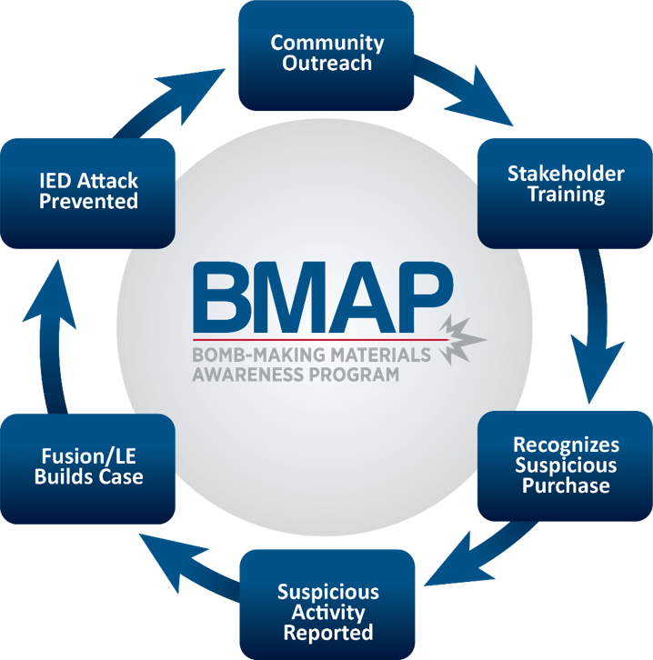
BMAP Approach
STOP ATTACKS
Build Public Awareness
Recognizes Suspicious Activity/Behavior
Educate Businesses
Notes:
The goal of the program is not only to build awareness and educate businesses, but to stop attacks from happening. Only with a committed and sustainable program, will communities be knowledgeable and feel comfortable enough to report suspicious activities to law enforcement. BMAP provides you the foundation and support to empower your community.
BMAP Overview. BMAP is a national outreach program sponsored by the Department of Homeland Security’s Office for Bombing Prevention in partnership with communities (SLTT or private sector).
Community Outreach: BMAP promotes private sector point-of-sale awareness and suspicious activity reporting to prevent misuse of common household items, such as explosive precursor chemicals (EPCs) and IED components.
Stakeholder Training: DHS certifies BMAP Administrator Trainers (ATs) and Community Liaisons (CLs) and provides them with guidance and materials for educating industries and businesses involved in the sale of bomb-making materials.
Recognizes Suspicious Purchase: BMAP increases prevention opportunities by building a network of aware and vigilant public safety officials and private sector partners to identify and report suspicious activities. This program creates more “eyes and ears” in the community.
Suspicious Activity Reported: Once suspicious activity is reported, a Suspicious Activity Report (SAR) is generated with law enforcement. An alternative option for reporting is to call 1-855-TELL-FBI.
Fusion/LE Builds Case: Law enforcement will conduct a preliminary investigation to see if the information reported could rise to the level where a full investigation would be warranted and necessary. The information may lead to surveillance and a possible arrest if the suspect or suspects are using EPCs for nefarious use.
IED Attack Prevented: BMAP is designed to create more “eyes and ears” throughout the nation. A community that is involved in this program has a higher likelihood to prevent and stop a terrorist/criminal before an IED is emplaced and used.

Slide 6
BMAP Community
Notes:
These members of the BMAP community are vital to the programs success and make up the eyes and ears of the total force.
Local Businesses. When local business owners decide to participate in BMAP, their employees receive training on identifying and reporting suspicious activity. The individuals provide valuable information to local law enforcement about potential threats. It is DHS’s goal for local business owners and operators to participate in the volunteer program, receive free training from their local BMAP Community Liaison, and include DHS-provided training in their annual employees training programs.
Dispatchers. Dispatchers decipher calls from local businesses reporting suspicious behaviors involving products identified as precursors chemicals, powders, and components used to make homemade explosives and IEDs. Even though a crime may not have been committed, Dispatchers document information about the incident per their department’s policy, and then notify Law Enforcement.
Public Safety Professionals. Public safety professionals are the first to respond to community incidents and are responsible for information gathering and investigation of suspicious bomb-making activity. The information they collect helps to “connect the dots” and identify potential use of explosives prior to an attack. The public safety professionals document the Who, What, Where Why of the incident and provide it to information-gathering agencies. From that information, a Suspicious Activity Report (SAR) is generated. Law enforcement agencies should have a procedure in place with local fusion center for entering the SAR and the FBI’s eGuardian system which serves as the single repository for these reports.
Analysts. After the SAR is approved and entered into eGuardian, it is reviewed by Guardian Management Unit (GMU) analysts to determine if the report meets criteria for further investigation. If the SAR meets the criteria, it is forwarded to the appropriate FBI Field Office for follow-up.
Senior Executives. Senior Executives have the authority to implement BMAP and encourage the coordination of community members and public safety professionals. By doing so, Senior Executives directly support the National Presidential Policy Directive for countering IEDs (PPD-17), which enhances their community’s counter-IED prevention measures. When community a community implements BMAP and works together, lives can be saved, the number of explosive-related threats can be drastically reduced, and the community is made safer.
Community. There are many people in the community who can also be leveraged to carry the BMAP message forward. More people involved in messaging and outreach will result in a safer community.

Slide 7
Operation Flashpoint

Slide 8
Operation Flashpoint
Purpose: To promote voluntary reporting of suspicious activity through outreach and awareness programs to private sector and public safety stakeholders in order to prevent acquisition of Explosive Precursor Chemicals for nefarious use.
#1 Awareness
Increase the awareness of businesses that sell EPCs, explosive powders, and other Bomb-Making Materials (BMM) on the risk and how they can voluntarily contribute to security.
#2 Suspicious Activity Reporting
Report Suspicious Activity to 855 -TELL- FBI (855-835-5324)
Notes:
#1 - Combining forces leverages the strengths and capabilities of both CISA and FBI, and further increases awareness from the top down; and the bottom up approach to explosive precursor chemical (EPC) point-of-sale (POS) retail outreach
#2 – Purchasing EPCs is legal and if the purchase or behavior was determined as a suspicious activity the caller should use the FBI line not 911 unless it is an emergency. The FBI call center has specially trained personnel to take the calls
*Throughout this briefing we will refer to all explosive and energetic material as EPCs. While black powder, black powder substitutes, reloading powder, and exploding target kits are technically explosive materials, they will be referred to as EPCs.
BMM = Bomb-Making Materials, everything included in S.I.M.P.C.E.
EPC = Explosive Precursor Chemicals i.e. Acetone, peroxide, strong acids, nitrates, powdered metals etc., that can be used to make a Main Charge Explosive
EM = Explosive Materials i.e. black powders, black powder substitutes, reloading powder, pyrotechnics, and exploding target kits that can be used as a Main Charge Explosive as they are sold in the store

Slide 9
Desired Outcomes
Prevent, disrupt, and mitigate bombing events
Increase and reinforce public and private partnerships
Increase in Suspicious Activity Reporting
Maximize current US Government resources
Maximize partnership through coordination, and deconfliction.
Ensure the reduction of duplicative efforts
Notes:
1.) Unknown at this time, quantifiably we won’t know until investigations occur
2.) Call centers received 1,000 related Tell-FBI phone calls with 8 Guardians initiated
3.) Evident via the total number of outreaches that occurred in the three months, partnership at the whole of government effort has strengthened throughout
4.) Through this mission, several current partnerships through the participating states have increased, Publix for example in Florida is interested in implementing OPF into their onboarding procedures.
5.) Same messaging from both departments has maximized the coordinated messaging campaign
6.) There has not been a duplicated outreach – due in large part to coordination and deconfliction within the field.

Slide 10
Fireworks/ Pyrotechnics

Slide 11
Explosives Incident Report (2020)
Pyrotechnics Data
2020 Bombing Events
There were a total of 428 bombing events in 2020. Consumer/ display fireworks were identified as the main charge in 82 or (20%) of those 428 bombing events.*
2016 – 2020 Explosion incidents
A total of 1,141 explosion incidents occurred from 2016 - 2020. In these explosion incidents, Commercial Explosives – Pyrotechnics/ Fireworks were identified as the main charge in 403 or (35%) of these cases. The next highest percentage is 259 (22%) of unknown main charges.*
2016 – 2020 Recoveries (Any event pre-detonation)
A total of 9,639 recoveries occurred from 2016 – 2020. In these recoveries, Commercial Explosives – Pyrotechnics/ Fireworks were identified in the recovery as the main charge in 2,214 or (23%) of these cases with an average of 442 cases per year.
Notes:
The EIR reviews bombing, and explosives related incidents from information reported to the United States Bomb Data Center (USBDC) through the Bomb Arson Tracking System (USBDC)
All data depicted does not represent the actual quantity of main charges but rather the number of reported incidents where 1 or more main charges were identified.

Slide 12
Fireworks Retail Locations
Region 8
Total
82
Region 7
194
1,723
Region 10
Region 5
33
361
I
X
VIII
Region 1
V
II
67
Region 2
Region 9
VII
III
38
72
Region 3
IX
103
VI
IV
Region 4
355
Region 6
418
*Size corresponds to amount*
OBP currently tracks approximately 250,000 retail locations across the US that commonly sell products containing EPCs through its BMAP TRIPwire Site.
*As of 24SEP2021*
Notes:
These business listings are broken down into Standard Industrial Classification Codes. (SIC)
Fireworks SIC Code – 509202
From 2016-2020 – Pyrotechnics, fireworks, mixtures, black powder (and substitutes) were the highest reported main charge material types in IED associated bombings.

Slide 13
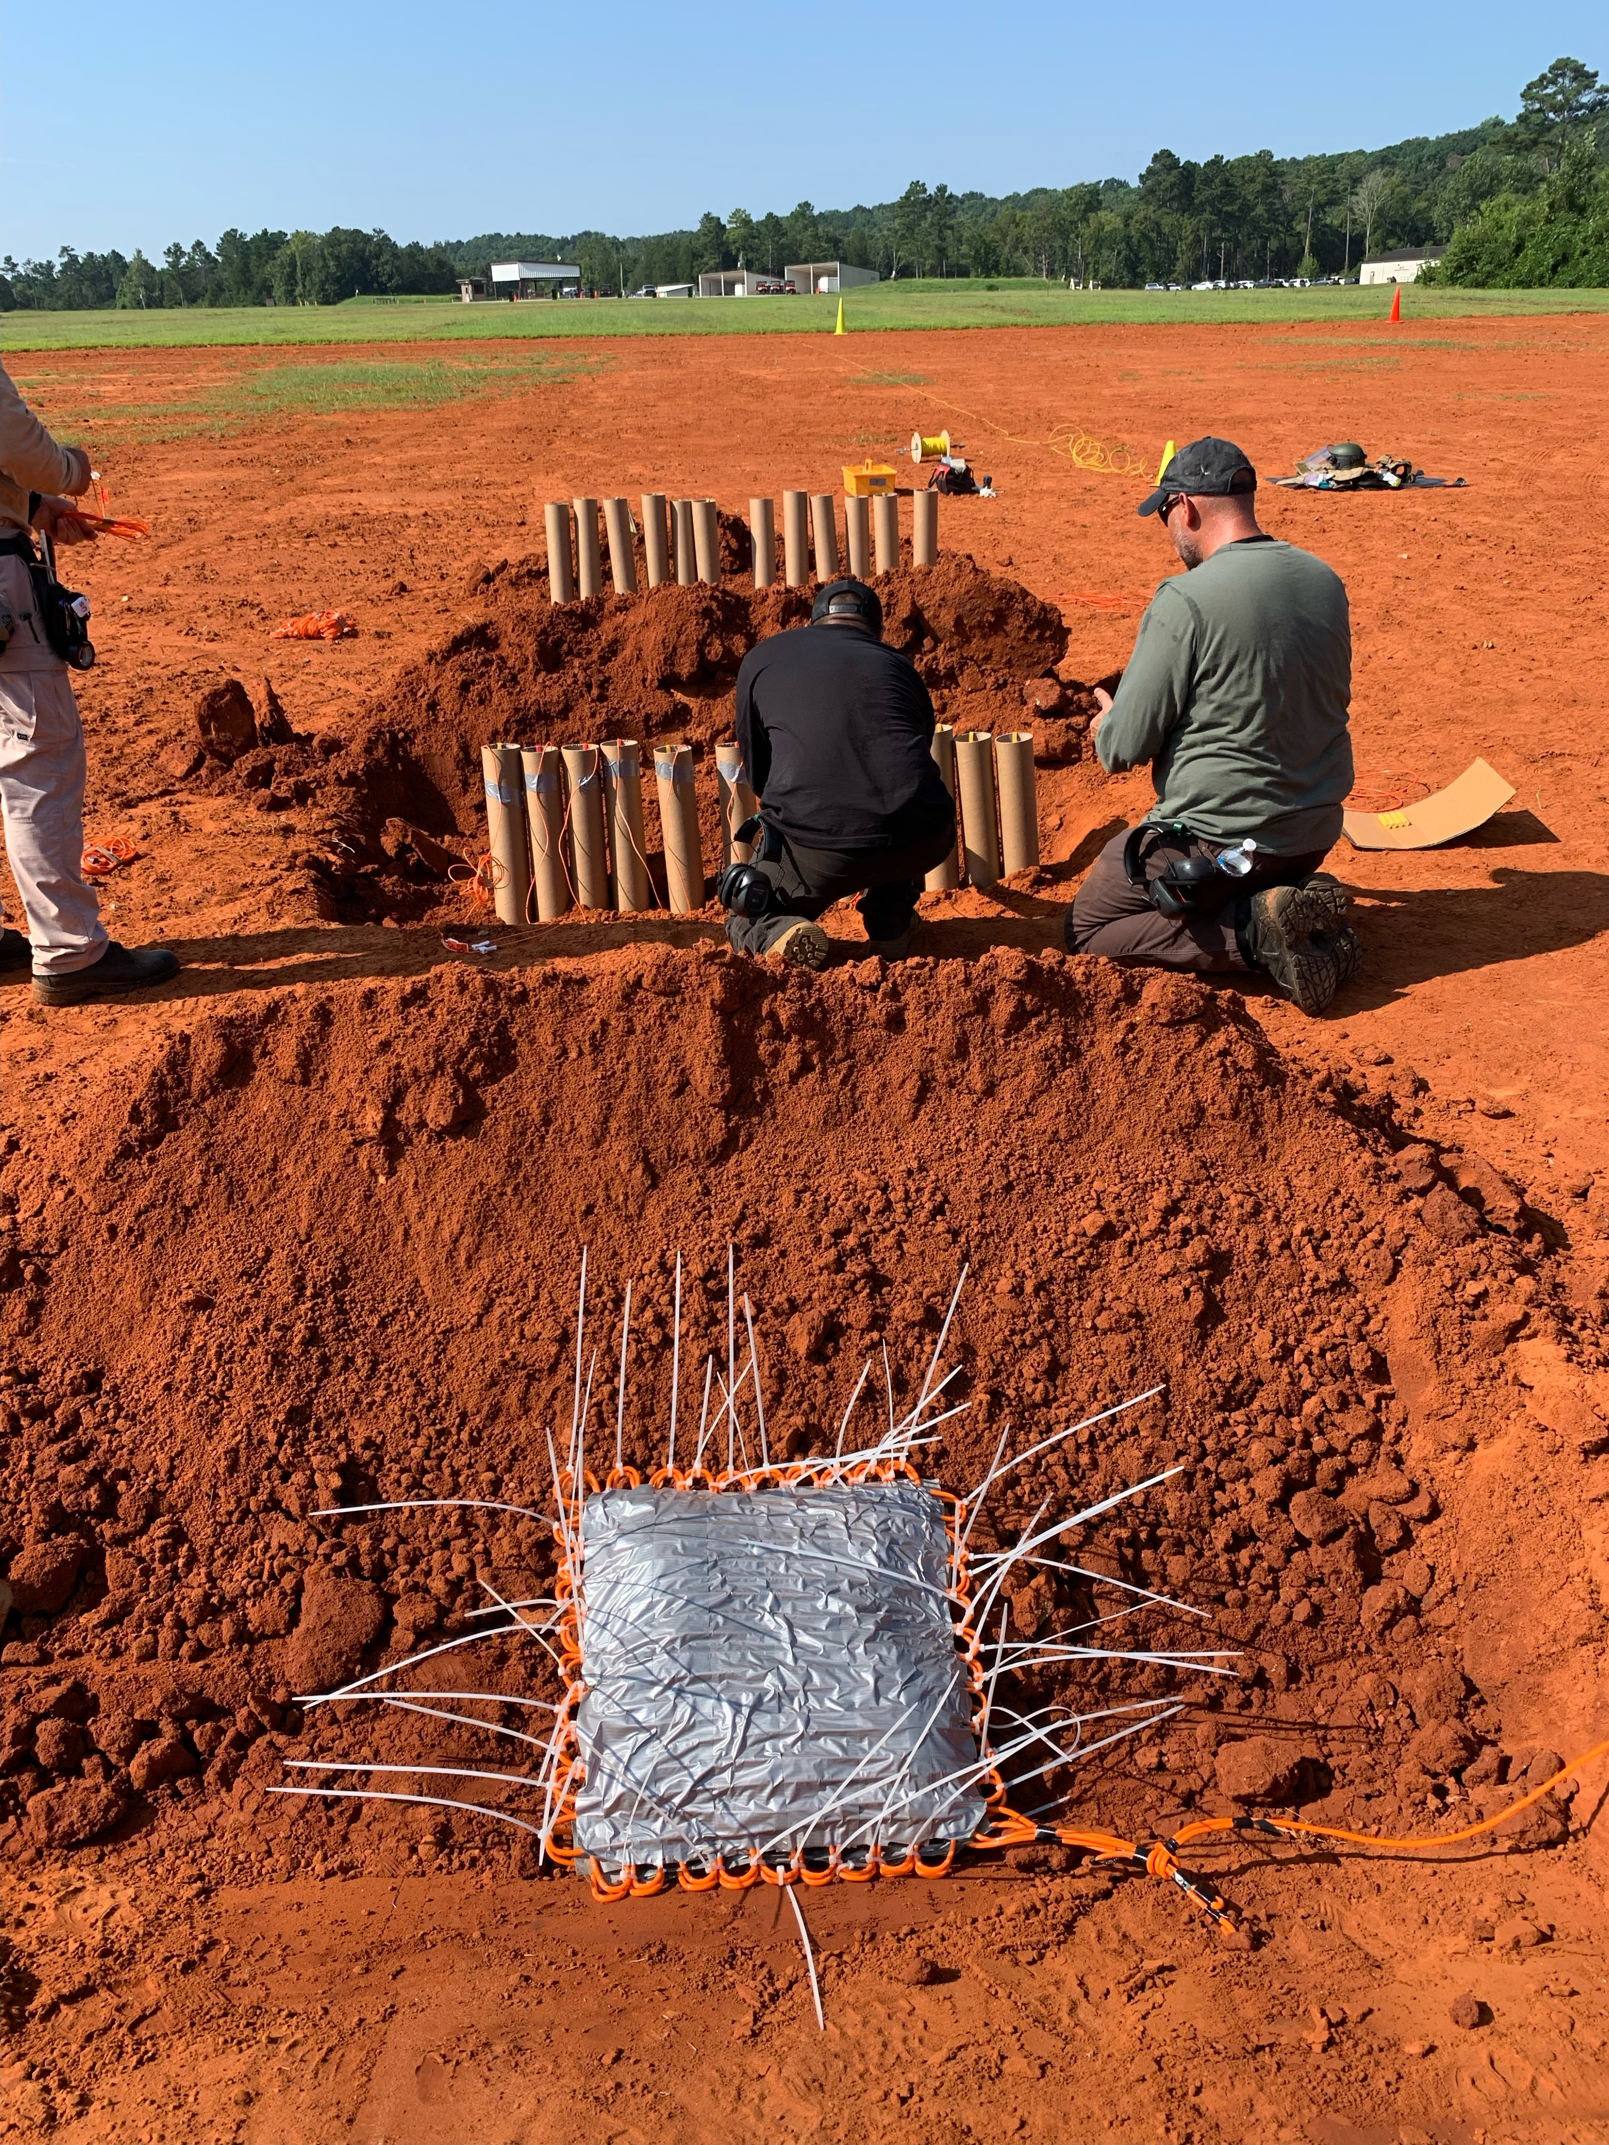
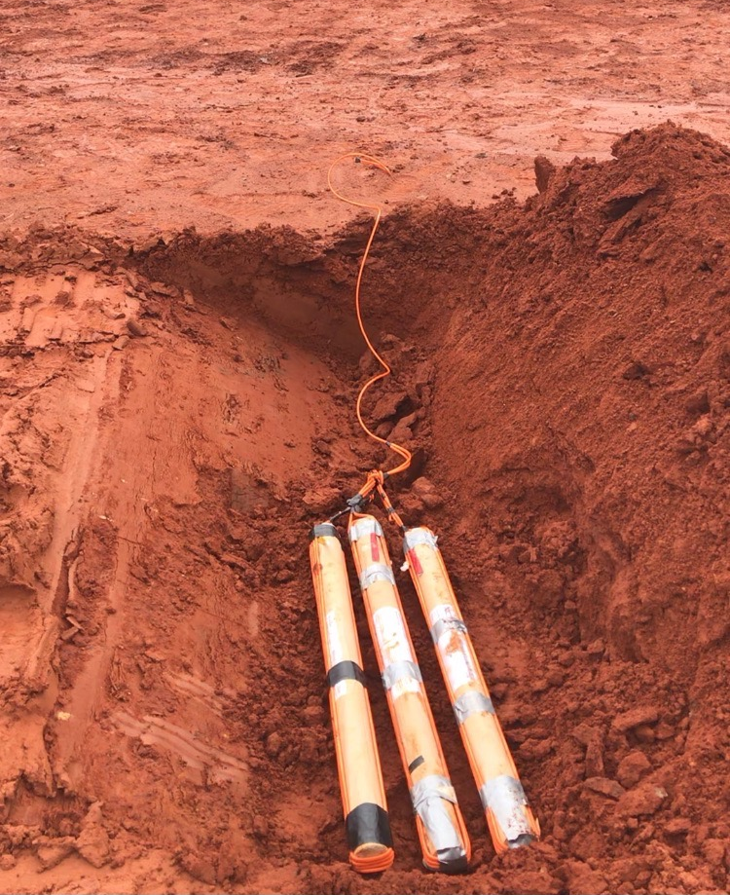
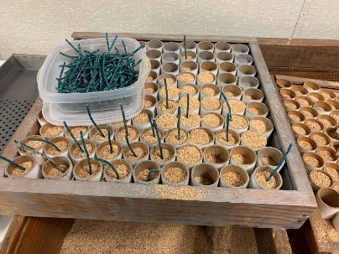
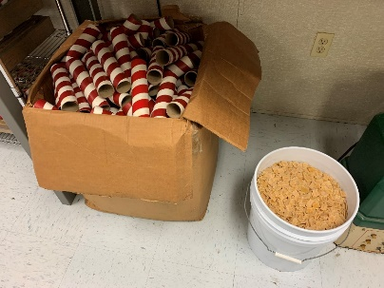
Fireworks Retail Locations
Data
Across the Nation, there are a total of 1,723 free-standing wholesale fireworks stores. Additionally, there are a total of 99 fireworks manufacturing and distribution centers.
This does not include the total number of pop-up fireworks stands that arise around the holiday season(s).
There are a total of approximately 1,822 fireworks/ pyrotechnic point of sale retail locations and distributors
Notes:
This data comes from aggregated governmental resources with a 95% accuracy rate. Approximately 10-15,000 businesses open and close EACH DAY.
Ask Question – does anyone know the possible number of popup stands that com during the holiday seasons?

Slide 14
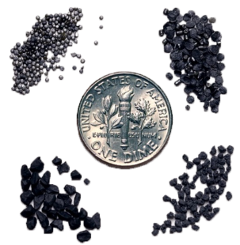
Explosive Powders
The Details
They are materials that create an explosion by their own energy
Explosive powder products are commonly used as bomb-making materials. Most bombing incidents in the United States involve the use of an explosive powder:
Black powder
Smokeless powder,
Flash powder,
Pyrotechnic fillers.
Explosive powders typically require confinement and normally burn when not confined.
Notes:
Photo at Bottom – Items Seized from the illegal Fireworks Seizure and Explosion in Los Angeles, CA
Explosive Powders. Explosive powder products are commonly used as bomb-making materials. The majority of bombing incidents in the United States involve the use of an explosive powder: black powder, smokeless powder, flash powder, and pyrotechnic fillers. All of these items burn when not confined.
Black powder. Gunpowder, also known as black powder to distinguish it from modern smokeless powder, is the earliest known chemical explosive. It consists of a mixture of sulfur, charcoal, and potassium nitrate.
Smokeless powder and black powder substitutes. The name given to a number of propellants used in firearms and artillery that produce negligible smoke when fired, unlike the black powder they replaced.
Flash powder. A composition of metallic fuel and an oxidizer such as chlorate. When the mixture is ignited, it burns extremely quickly producing a bright flash. Different varieties of flash powder are made from different compositions; most common are potassium perchlorate and aluminum powder.
Pyrotechnic fillers. Materials capable of undergoing self-contained and self-sustained exothermic chemical reactions for the production of heat, light, gas, smoke and/or sound. For example, pyrotechnic powders such as mortars and fireworks.

Slide 15
Boston Marathon Bombing
Notes:
Boston Marathon Bombing. In the 2013 Boston Marathon Bombing two explosions near the marathon’s finish line causing deaths and mass injuries.

Slide 16
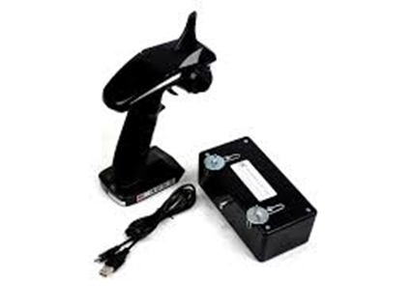
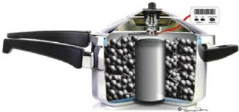
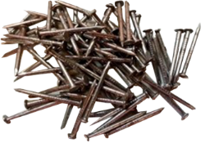
Commercially Available Products – Boston Marathon Bombing
Switch: remote control from toy car
Initiator: Christmas lights
Explosive:
Fireworks
Power source: batteries
Container: pressure cooker/ backpack
Shrapnel: nails and BB’s
Notes:
Boston Marathon Bombing – Commercially Available Products. The Tsarnaev brothers constructed the 2013 Boston Marathon bombs using only legally purchased materials. They were able to take common household items like model car parts, Christmas tree lights, and pressure cookers and turn them into something deadly. The commercially available products used as explosive precursors and IED components in the Boston Marathon Bomb were the following:
Switch - remote control from toy car
Initiator - Christmas lights
Main Charge - fireworks
Power Source - batteries
Container - pressure cooker / backpack
Enhancement - nails and BB's

Slide 17
Fireworks BE ALERT Card (Front)

Slide 18
Fireworks BE ALERT Card (Back)

Slide 19
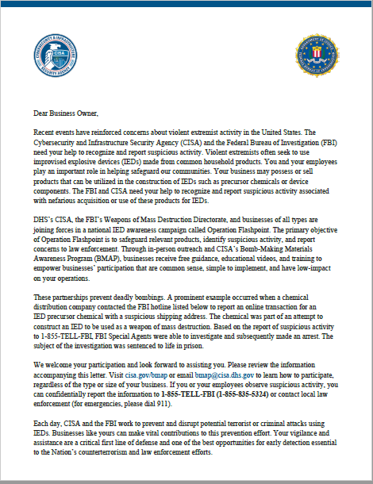
Marketing Campaign
Front
Campaign Letter
Back
Notes:
The BMAP program will be emailing about 500K businesses and direct mailing 200K

Slide 20
BMAP Resources
BMAP Videos
BMAP Website

Slide 21
For more information:
www.cisa.gov/obp
OFFICE FOR BOMBING PREVENTION
BMAP Contact information
BMAP@cisa.dhs.gov
Stay Informed, Subscribe!

